Slide 1
Chapter 7
Tumor Suppressor Genes
Nov 10, 2023

Slide 2
Outline of today`s lecture
1, two-hit hypothesis and the discovery of the first tumor suppressor-RB.
2, familial cancer(家族性癌) syndromes and tumor suppressors genes:
NF1 and Neurofibromatosis（神经纤维瘤）;
APC and Familial adenomatous（腺瘤） polyposis（息肉）;
VHL and hypoxia（缺氧）;

Slide 3
What is “tumor suppressor genes”?
Tumor suppressor genes (TSGs): anti cancer/tumor genes, including: anti-proliferation, survival, metastasis… genes.
History for identifying “tumor suppressor genes”
The criteria for “tumor suppressor genes” ?

Slide 4
7.1 Cell fusion experiments indicate that the cancer phenotype is recessive

Slide 5
Recessive and dominant phenotype of cancer
Introduction of a tumor virus genome into a normal cell would result in transformation of that cell. This response meant that viral oncogenes could overrule these cellular genes, by definition the viral oncogenes were able to induce a dominant phenotype
However, as was suspected at the time, and reinforced by research in the 1980s, most human cancers did not seem to arise as consequences of tumor virus infections.

Slide 6
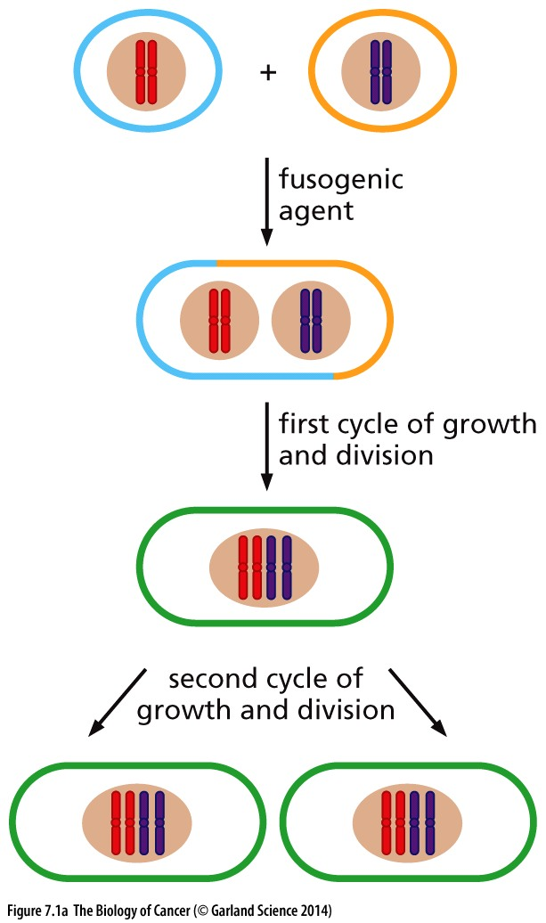
Figure 7.1 Experimental fusion of cells
(A) When cells growing adjacent to one another in monolayer culture are exposed to a fusogenic agent, such as inactivated Sendai virus or polyethylene glycol (PEG), they initially form a heterokaryon with multiple nuclei. When the heterokaryon subsequently passes through mitosis, the two sets of parental chromosomes are pooled in a single nucleus. During propagation of the resulting tetraploid(四倍体) cell in culture, the descendant cells often shed some of these chromosomes, thereby reducing their chromosome complement to a quasi-triploid(准三倍体) or hyperdiploid(超二倍体) state.
Notes:
Cell fusion是一个很有意思的实验技术，最成功利用是制备杂交瘤，生产单克隆抗体；cell fusion technique play an important role in identifying cell cycle controlling machinery. cell fusion also happens in real physiological conditions, like muscle formation.

Slide 7
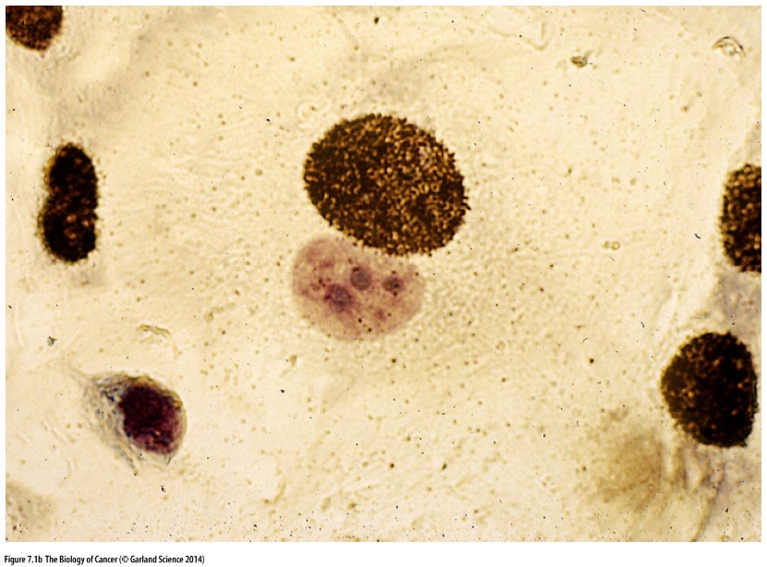
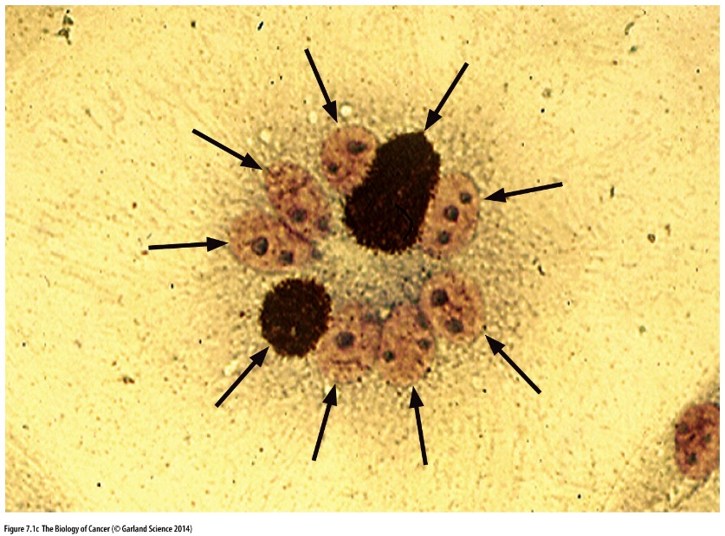
Figure 7.1 Experimental fusion of cells
(B) In this image, radiolabeled mouse NIH 3T3 cells have been fused (using Sendai virus) with monkey kidney cells, resulting in a hybrid cell with two distinct nuclei. The (larger) mouse nucleus is identified by the silver grains that were formed during subsequent autoradiography.
(C) Polykaryons(多核) may form with equal or greater frequency following such fusions but are usually unable to proliferate and spawn progeny. This polykaryon contains nine nuclei (arrows).

Slide 8
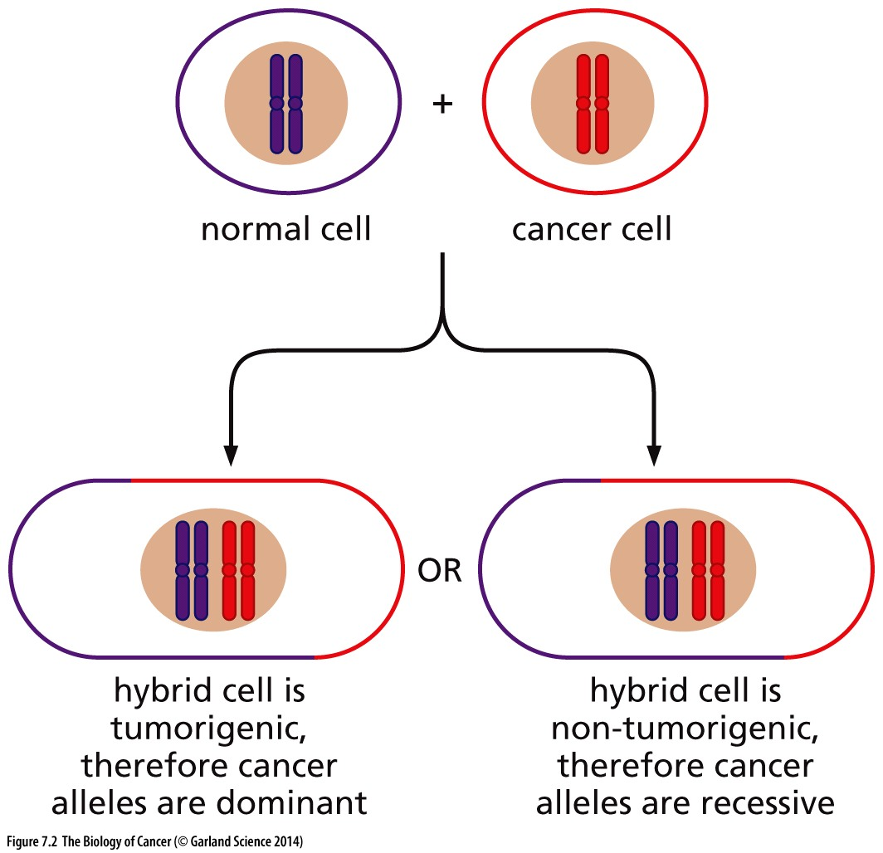
Figure 7.2 Dominance and recessiveness of the tumorigenic phenotype
The use of cell fusion to test the dominance or recessiveness of the cancer cell phenotype can, in theory, yield two different outcomes— tumorigenic or non-tumorigenic hybrid cells. In fact, when cancer cells derived from most kinds of non-virus-induced human tumors (or from chemically induced rodent tumors) were used in these fusions, the hybrid cells were non-tumorigenic. In contrast, when the cancer cell derived from a virus induced tumor, the hybrids were usually tumorigenic.

Slide 9
7.2 The recessive nature of the cancer cell phenotype requires a genetic explanation

Slide 10
The meaning of the recessive nature of some cancer cell
Cancer initiation/progression requires two separate genetic alterations. So theoretically tumor suppressor genes should exist.
Notes:
上世纪70-80年代oncogene发现后，对于是否存在tumor suppressor gene存在很大争议

Slide 11
7.3 The retinoblastoma tumor provides a solution to the genetic puzzle of tumor suppressor genes

Slide 12
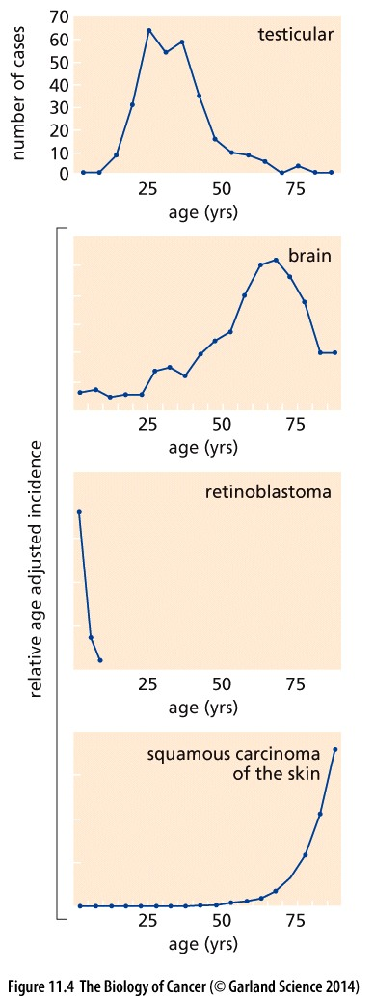
Retinoblastoma (视网膜母细胞瘤)
Retinoblastoma is a rare childhood eye tumor.
This tumor of the retina, arising in the precursors of photoreceptor cells, is normally observed in about 1 in 20,000 children (Figure 7.3). It is diagnosed anytime from birth up to the age of 6 to 8 years, after which the disease is rarely encountered.

Slide 13
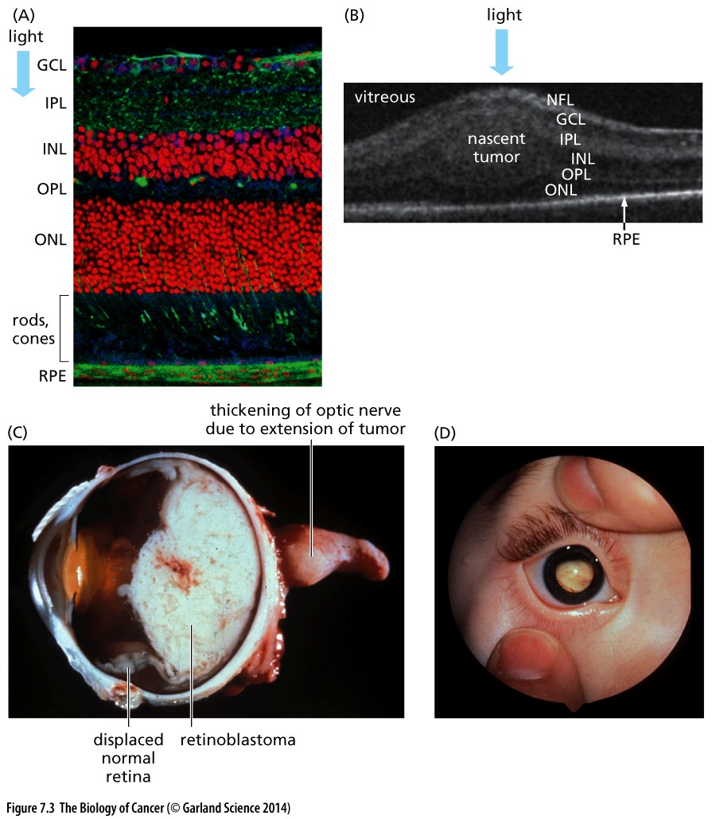
Figure 7.3 Pediatric retinoblastomas
For still incompletely understood reasons, defects in the Rb gene lead preferentially to the formation of pediatric tumors in the retina, a small, highly specialized tissue, even though the Rb gene is active in governing cell proliferation in most cell types throughout the body.

Slide 14
Sporadic and familial form of retinoblastoma
Because this tumor strikes in children lacking a family history, it is considered to be a manifestation of the sporadic form of this disease. (Since this form of the disease affects only a single eye, it is often termed unilateral retinoblastoma.)
The familial form of retinoblastoma appears in children having a parent who also suffered from and was cured of the disease early in life. In this instance, there are usually multiple foci of tumors arising in both eyes (and the condition is therefore called bilateral retinoblastoma).

Slide 15
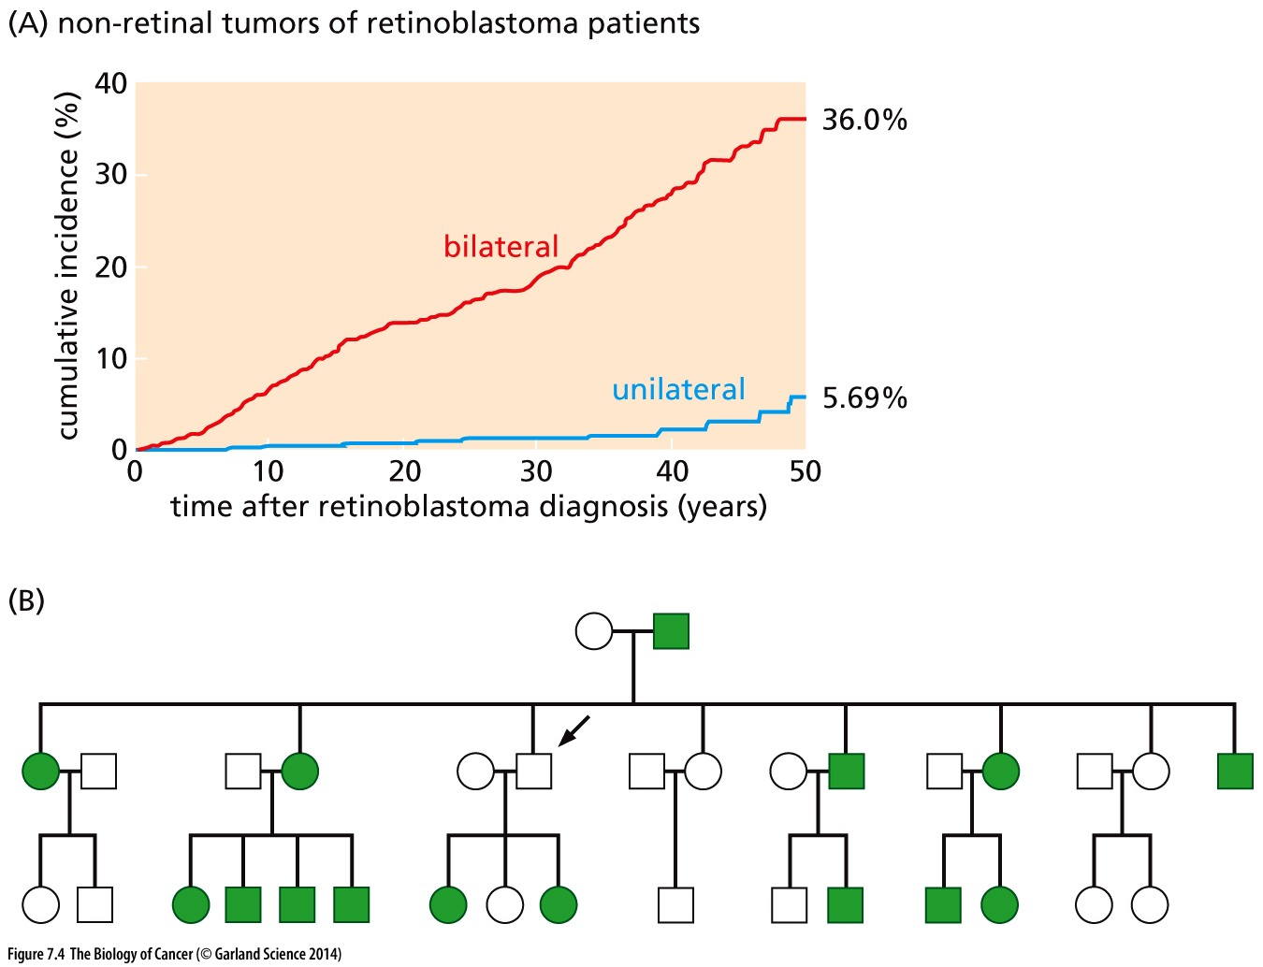
Figure 7.4 Unilateral versus bilateral
retinoblastoma
As is apparent, those cured of bilateral tumors (red line) have a dramatically higher risk of subsequently developing tumors in a variety of organ sites than those with unilateral tumors (blue line).

Slide 16
Two-hit hypothesis
The Knudson hypothesis, also known as the two-hit hypothesis or multiple-hit hypothesis, is the hypothesis that cancer is the result of accumulated mutations to a cell's DNA. It was first proposed by Carl O. Nordling in 1953, and later formulated by Alfred G. Knudson in 1971. Knudson's work led indirectly to the identification of cancer-related genes. Knudson won the 1998 Albert Lasker Clinical Medical Research Award for this work.
Later, Knudson performed a statistical analysis on cases of retinoblastoma, a tumor of the retina that occurs both as an inherited disease and sporadically. He noted that inherited retinoblastoma occurs at a younger age than the sporadic disease. In addition, the children with inherited retinoblastoma often developed the tumor in both eyes, suggesting an underlying predisposition. Knudson suggested that multiple "hits" to DNA were necessary to cause cancer. In the children with inherited retinoblastoma, the first insult was inherited in the DNA, and any second insult would rapidly lead to cancer. In non-inherited retinoblastoma, two "hits" had to take place before a tumor could develop, explaining the age difference.
Notes:
癌症发生的理论模型：癌症背后到底有几个决定因素？

Slide 17
One-hit, two-hit, multi-hit tumorigenesis model
y= ax²
y= ax^{n}
y(癌症发病率)
y(癌症发病率)
y(癌症发病率)
y= ax
X(年龄)
X(年龄)
X(年龄)
One-hit
two-hit
multi-hit
In most simple case
Notes:
癌症到底有几个决定因素，一般而言可以假定每个因素的出现随时间正相关

Slide 18
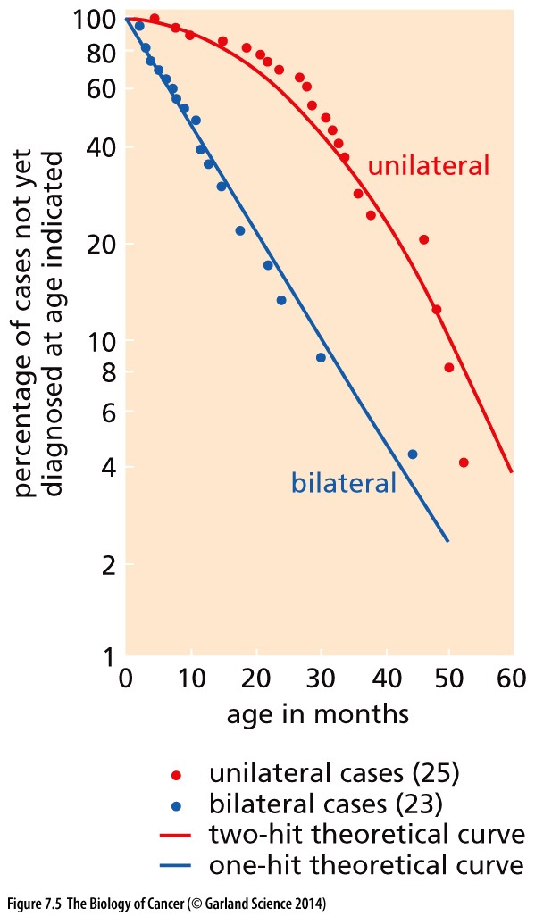
Figure 7.5 Kinetics of appearance of unilateral and bilateral retinoblastomas
Alfred Knudson Jr. studied the kinetics with which bilateral and unilateral retinoblastomas appeared in children. He calculated that the bilateral cases (tumors in both eyes) arose with one hit kinetics, whereas the unilateral tumors (affecting only one eye) arose with two-hit kinetics. Each of these hits was presumed to represent a somatic mutation. The fact that the two-hit kinetics involved two copies of the Rb gene was realized only later.
In 1971
Notes:
有些科学发现看起来似乎very simple，实际上意义非常大！！

Slide 19
Knudson`s contribution
In 1971
Knudson`s contribution: propose a theoretical cancer formation model only based on statistical data. This statistical data only include the age when retinoblastoma develop.
Knudson won the 1998 Albert Lasker Clinical Medical Research Award for this work.
Notes:
RB gene was cloned by Weinberg and others in 1986

Slide 20
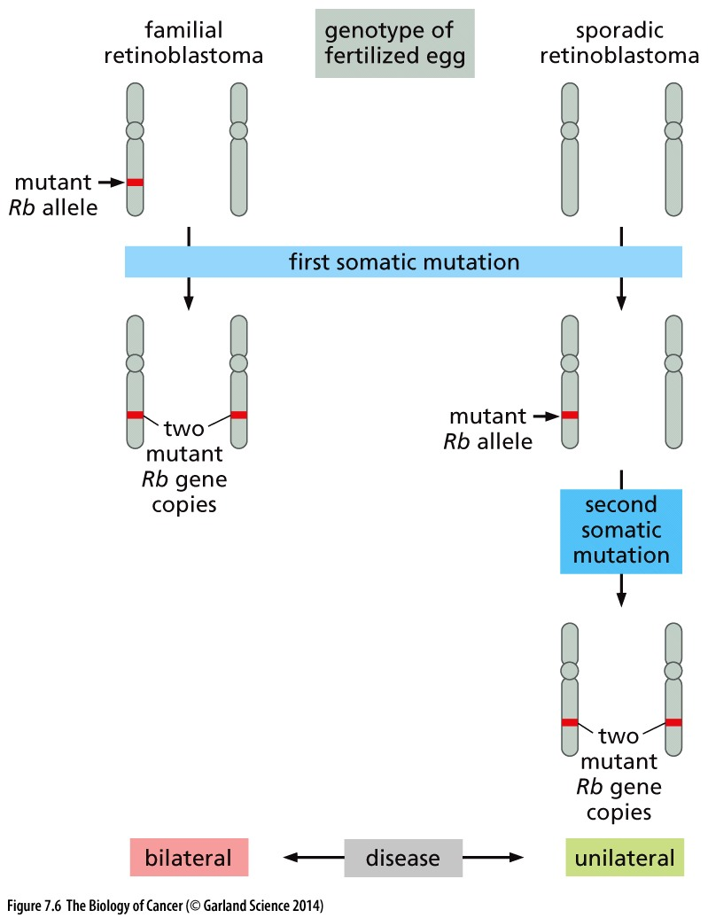
Figure 7.6 Dynamics of retinoblastoma formation
Notes:
目前对retinoblastoma发病原因的理解

Slide 21
7.4 Incipient （初期的）cancer cells invent ways to eliminate wild-type copies of tumor suppressor genes
1. Mitotic recombination;
2. Gene conversion;
3. Chromosomal nondisjunction (不分离);
Notes:
How the two hits become realized? First come from mutation or inheritance, the other come from? Besides mutation, other clever ways to loss tumor suppressor genetically by cancer cells…

Slide 22
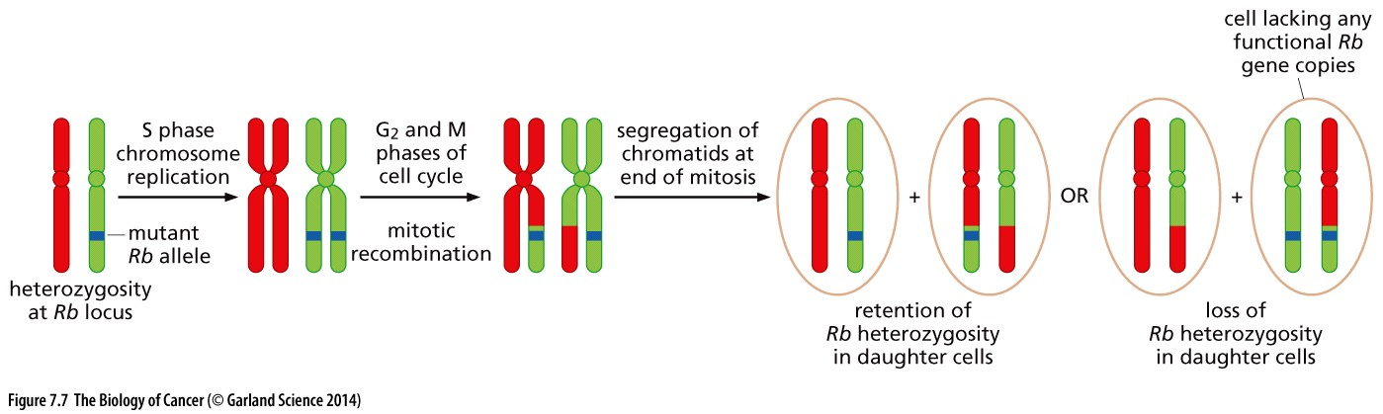
Mitotic recombination can lead to loss of heterozygosity (LOH) of Rb.
Normally, recombination between chromosomes was known to occur almost exclusively during meiosis. mitotic recombination occurs during active cell proliferation, was found to occur at a frequency of 10^{–5} to 10^{–4} per cell generation.

Slide 23
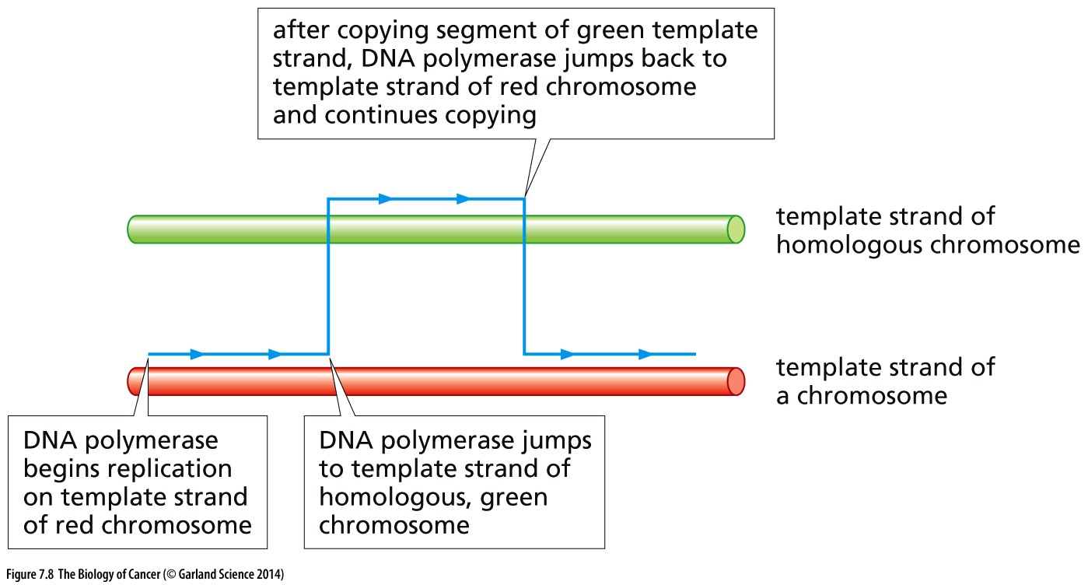
Figure 7.8 Gene conversion
During the process of DNA replication

Slide 24
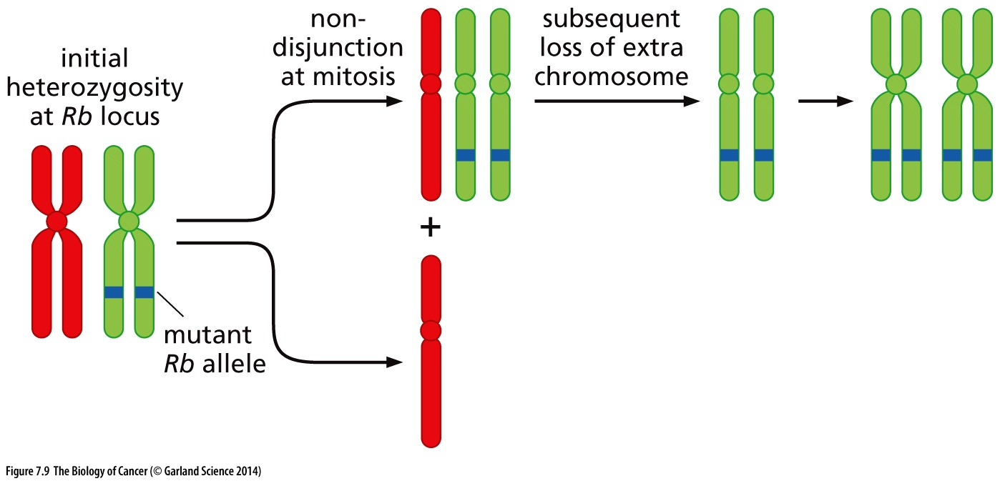
Figure 7.9 Chromosomal nondisjunction (不分离) and loss of heterozygosity (LOH)
During cell division

Slide 25
7.5 The Rb gene often undergoes loss of heterozygosity in tumors

Slide 26
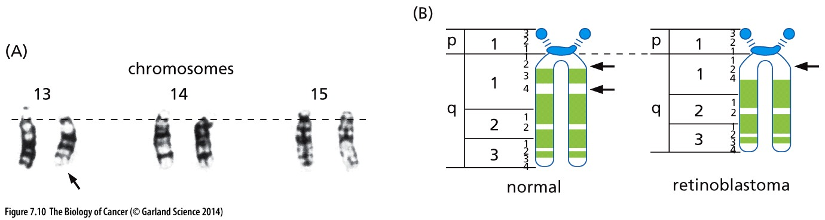
Figure 7.10 Chromosomal localization of the Rb locus
(A) The characteristic darkly staining bands of each human chromosome delineate that chromosome’s specific subregions. In this case, careful study of the karyotype of retinoblastoma cells, performed on the condensed chromosomes of late prophase or metaphase cells, revealed a deletion in the long arm (q) of Chromosome 13 in a 6-year-old retinoblastoma patient (arrow), while Chromosomes 14 and 15 appeared normal.
(B) Careful cytogenetic analysis revealed that the deletion was localized between bands 13q12 and q14, that is, between the 2nd and 4th bands of the 1st region of the long arm of Chromosome 13.

Slide 27
Experiments to test LOH
Through good fortune, a second gene lying in the 13q14 chromosomal region had already been reasonably well characterized. This gene, which encodes the enzyme esterase D, is represented in the human gene pool by two distinct alleles whose protein products migrate at different rates in gel electrophoresis (Figure 7.11). The esterase D locus presented geneticists with a golden opportunity to test the LOH theory.
Notes:
大部分LOH并不能通过简单核型分析来发现

Slide 28
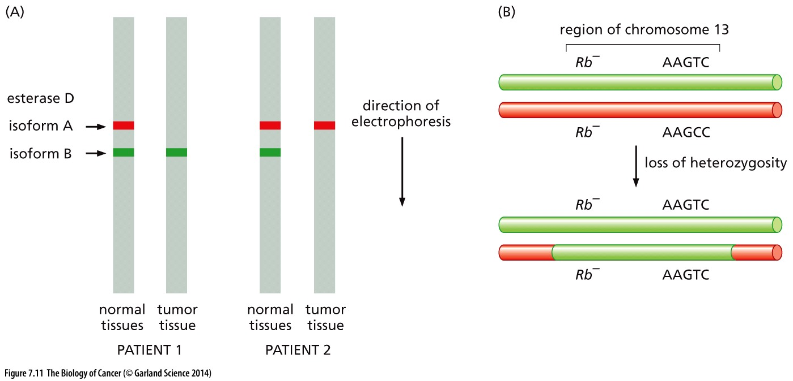
Figure 7.11 Demonstrations of loss of heterozygosity at the Rb locus

Slide 29
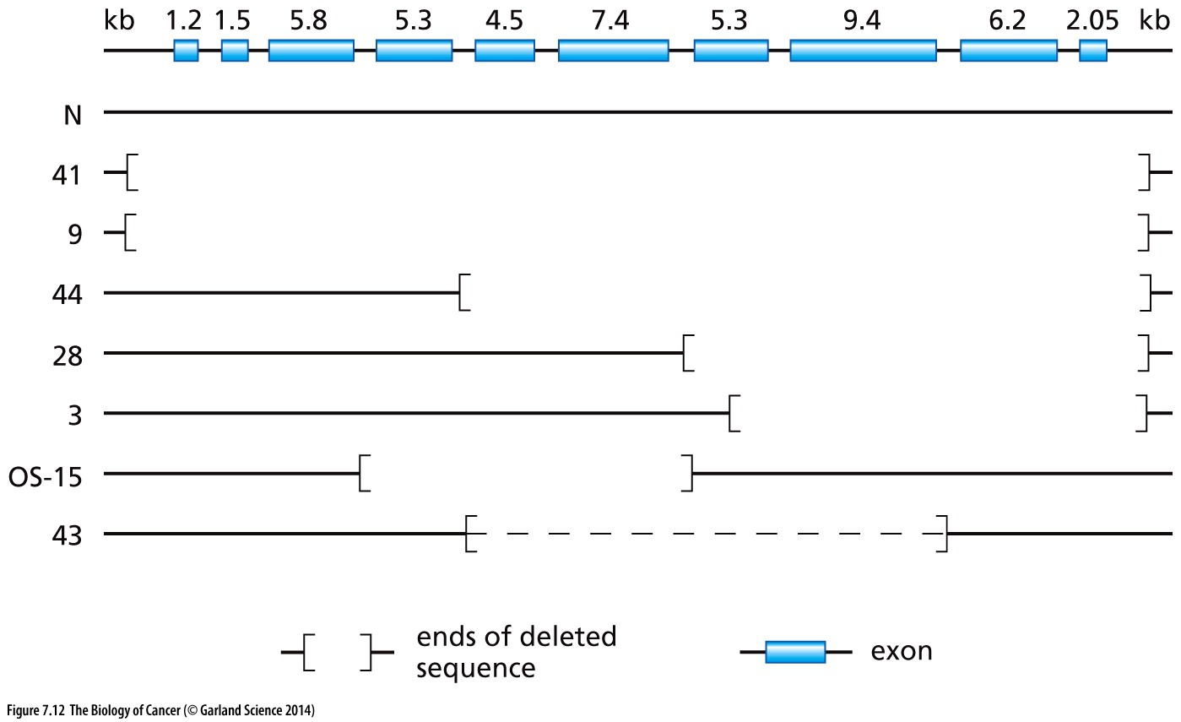
Figure 7.12 Mutations of the Rb gene
In 1986 the Rb gene was cloned with the aid of a DNA probe that recognized an anonymous genomic sequence located somewhere in Chromosome 13q14. Additional DNA probes derived from different portions of the cloned gene revealed, as was previously speculated, that the Rb gene in retinoblastomas suffered mutations that resulted in its inactivation (Figure 7.12).
Notes:
不同retinoblastoma病人，删除的具体DNA区域不一样

Slide 30
7.6 Loss-of-heterozygosity events can be used to find tumor suppressor genes
Since the chromosomal region flanking a tumor suppressor gene seemed to undergo LOH together with the TSG itself, one might be able to detect the existence of a still-uncloned tumor suppressor gene simply from the fact that an anonymous genetic marker lying nearby on the chromosome repeatedly undergoes LOH during the development of a specific type of human tumor.
Genetic markers:
Restriction fragment length polymorphism (RFLP)
Single-nucleotide polymorphisms (SNPs)
Notes:
常规遗传定位实验，目的是寻找未知的基因

Slide 31
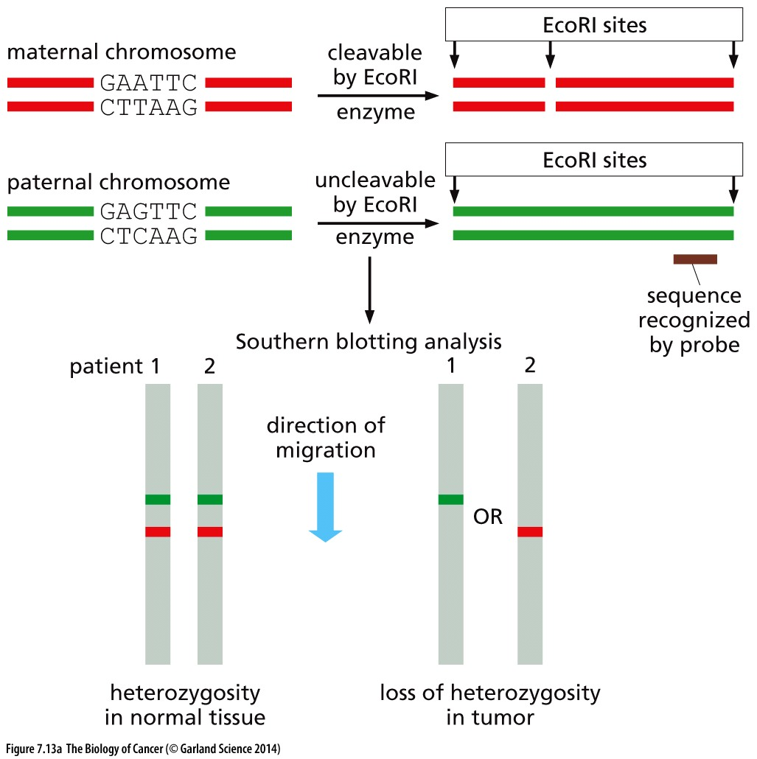
Figure 7.13 Restriction fragment length polymorphisms and localization of tumor suppressor genes
Notes:
Restriction fragment length polymorphism (RFLP)位点少，定位精度不高

Slide 32
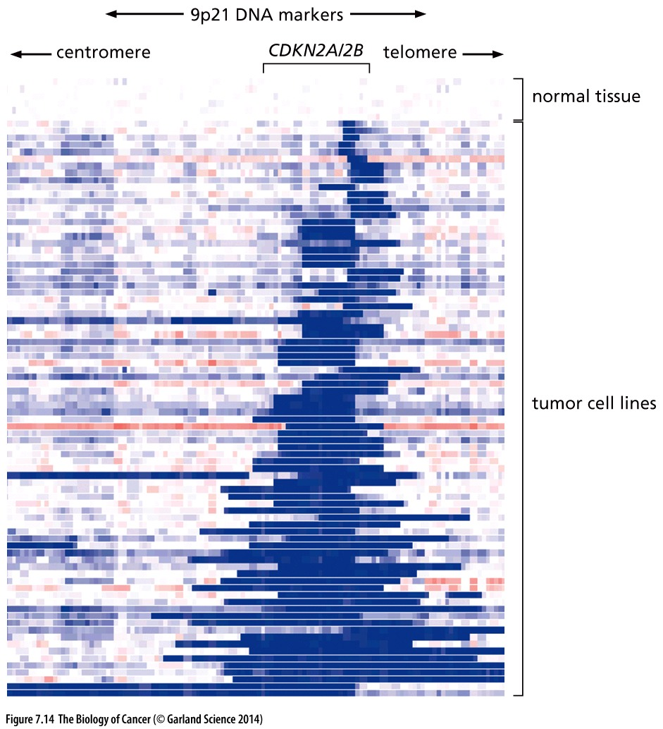
Figure 7.14 Measurement of deleted chromosomal segments carrying tumor suppressor genes
a set of 250,000 SNP probes was used; the probes were planted at an average density of one per 12 kb across the genome. DNAs of 80 tumor cell lines (arrayed top to bottom, names deleted) were analyzed for the presence or absence of sequences reactive with the probes. Short homozygous deletions (dark blue bars) affecting one or both of the adjacent pair of TSGs mapping to chromosome 9p21—CDKN2A and CDKN2B—have been found to occur frequently.
SNP array analysis
Notes:
SNP是目前遗传基因定位最常用的标记

Slide 33
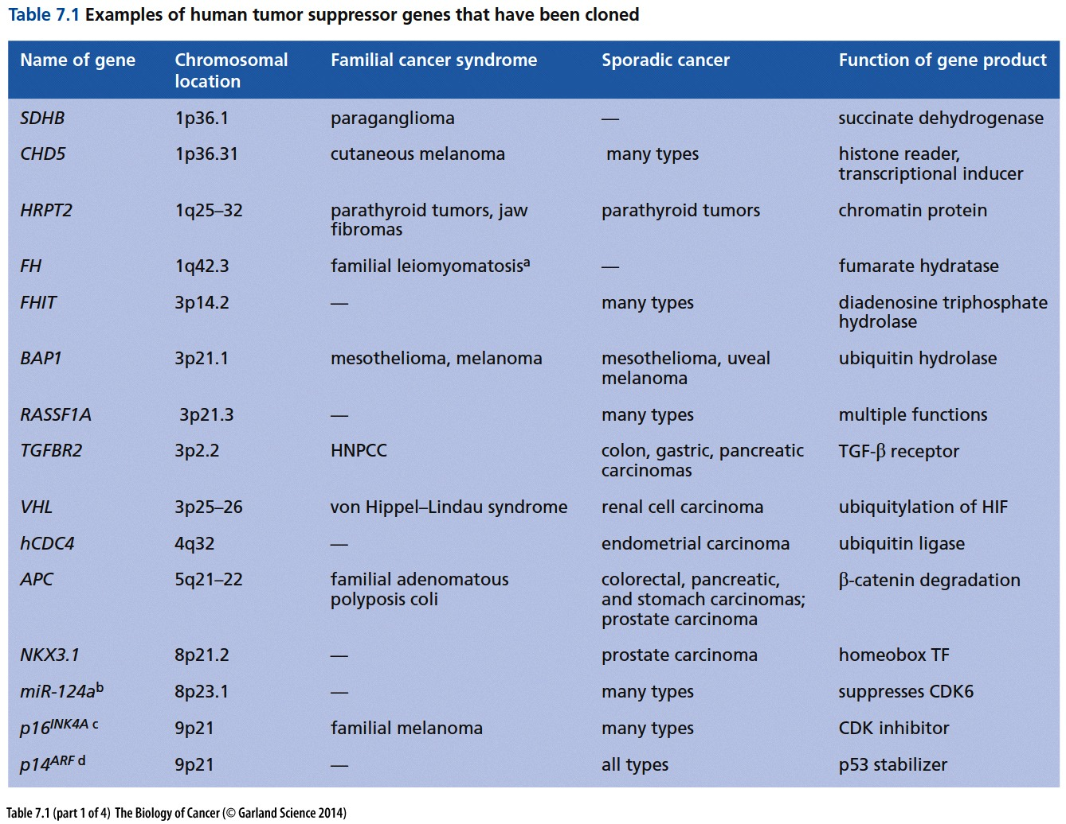

Slide 34
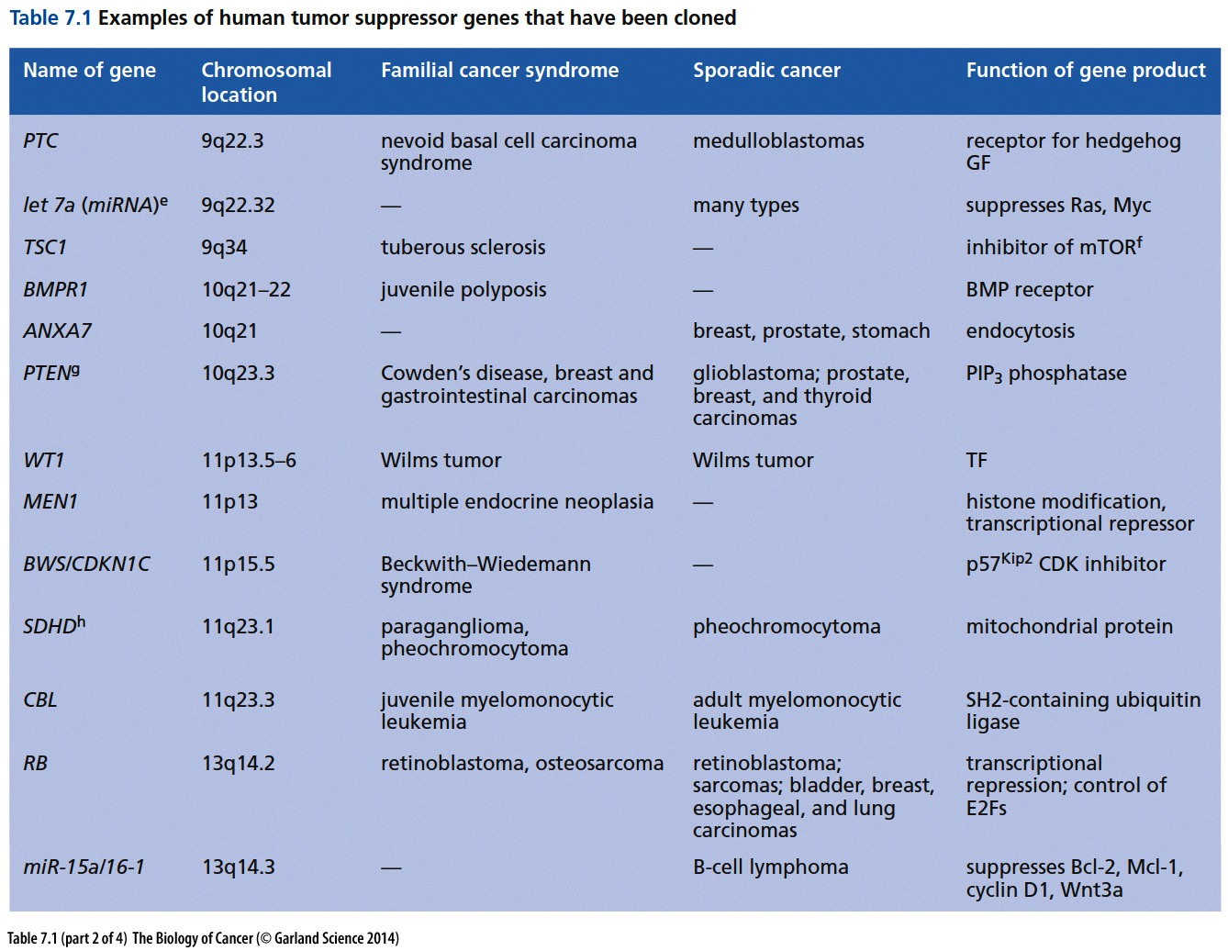

Slide 35
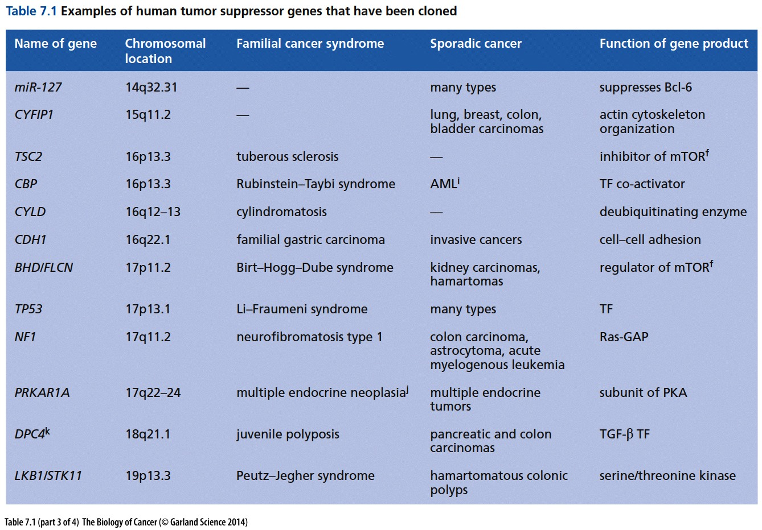

Slide 36
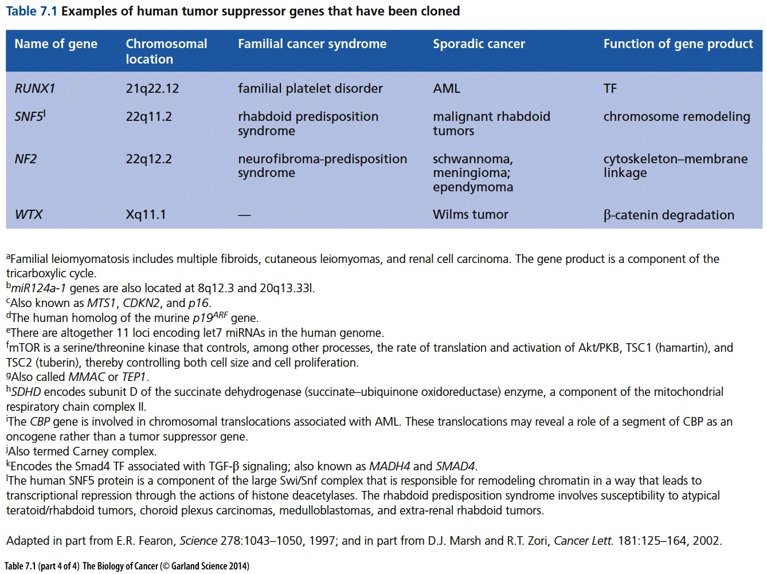

Slide 37
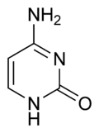
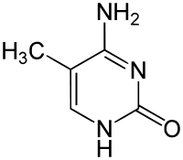
7.8 Promoter methylation represents an important mechanism for inactivating tumor suppressor genes
Two of DNA's four nucleotides, cytosine and adenine, can be methylated. Adenine methylation is restricted to prokaryotes.
Cytosine
5-Methylcytosine
CpG methylation can be transmitted from cell to cell heritably (see Section 1.9), it represents a highly effective way to ensure that descendant cells, many cell generations removed from an early embryo, continue to respect and enforce the decisions made by their ancestors in the embryo.
Notes:
前面提到TSG基因LOH失活，另一种TSG功能失活的方式：启动子甲基化修饰，除此之外。。。

Slide 38
CpG islands and DNA methylation
In mammalian cells, this methylation is found only when these bases are located in a position that is 5ʹ to guanosines, that is, in the sequence CpG. When CpG methylation occurs in the vicinity of a gene promoter, it can cause repression of transcription of the associated gene
There are often localized regions of DNA—regions with a high density of CpGs called “CpG islands”. These CpG islands are often affiliated with the promoters of genes (Figure 7.15), and their methylation by DNA methyltransferases silences transcription, resulting in the shutdown of genes that should, by all rights, remain transcriptionally active. (A recent survey indicated that about 70% of all genes in the human genome have CpG islands affiliated with their promoters, yielding a total of ~14,000 genes that are, in principle, vulnerable to inappropriate shutdown by methylation.)

Slide 39
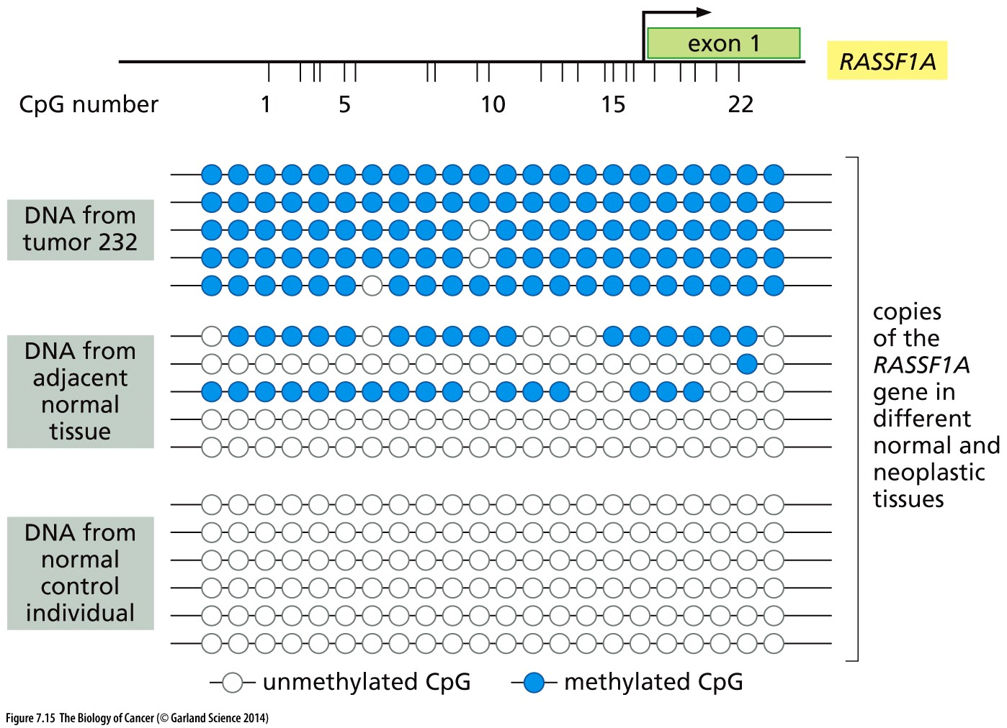
Figure 7.15 Methylation of the RASSF1A promoter
RASSF1A tumor suppressor blocks cell cycle progression and inhibits cyclin D1 accumulation

Slide 40
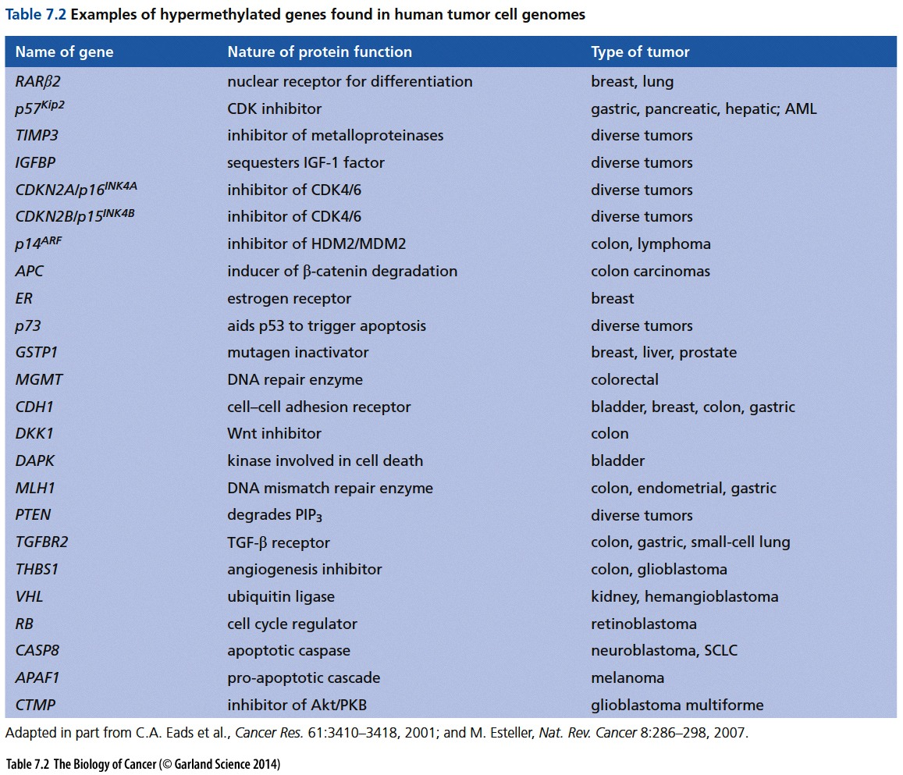

Slide 41
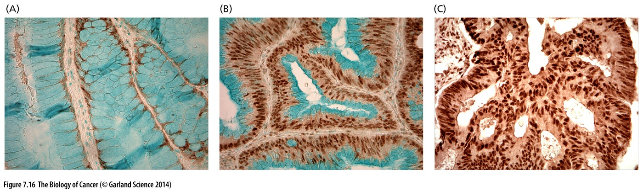
Figure 7.16 Expression of the DNMT3B enzyme in colon carcinomas
(A) In normal colonic tissue, the enzyme is hardly expressed.
(B) In this well-differentiated, less aggressive adenocarcinoma, DNMT3B is expressed strongly in the nuclei of carcinoma cells, which are located away from the lumina of acini (open spaces; clear) formed by the carcinoma cells, while the mucin-containing cytoplasms are located apically.
(C) In a less differentiated, more aggressive colon carcinoma, DNMT3B is intensely expressed in the nuclei of all the carcinoma cells, which no longer exhibit the apically localized mucin.
Notes:
Tumor suppressor 启动字甲基化的可能原因

Slide 42
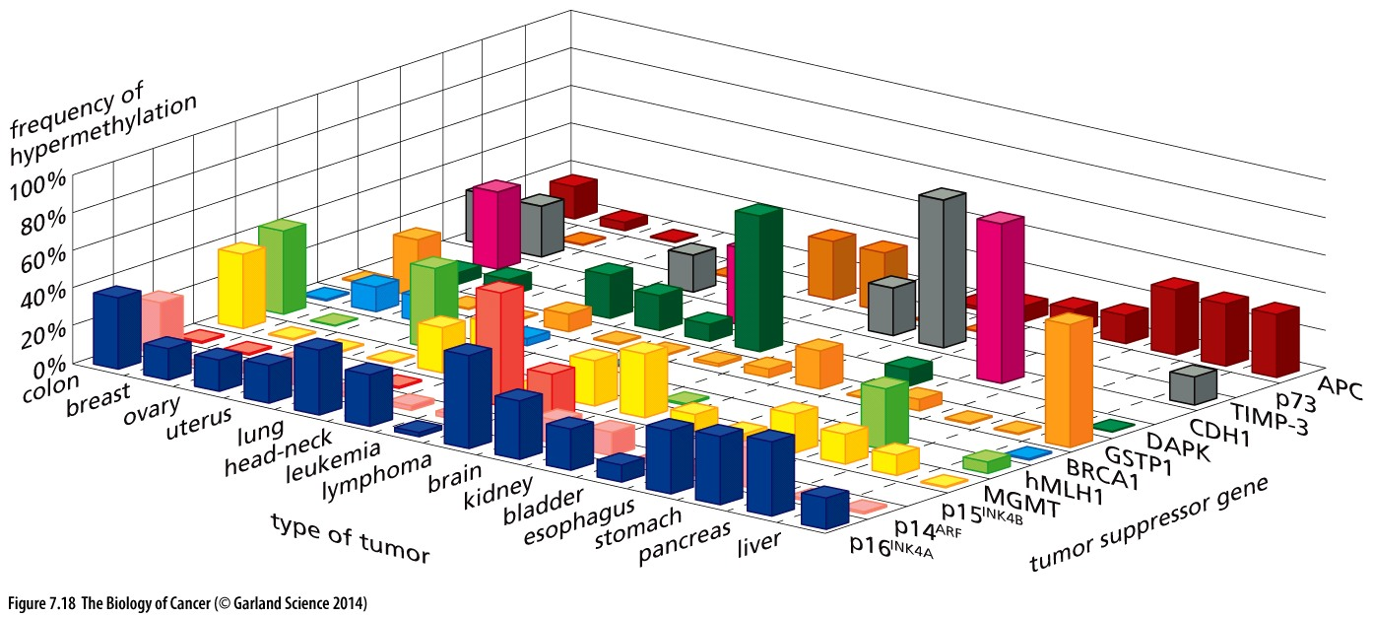
Figure 7.18 Methylation of multiple genes within tumor cell genomes
Notes:
仅供参考

Slide 43
Genetic causes for Familial cancer (家族性癌)
RB: Retinoblastoma;
NF1: neurofibromatosis (神经纤维瘤病)
TP53: Li-Fraumeni syndrome;
PTEN: Cowden syndrome;
APC: Familial adenomatous polyposis;
VHL: Von Hippel–Lindau syndrome;
BRCA1: hereditary breast-ovarian cancer syndrome
Why proto-oncogene alteration is rarely involved in Familial cancer?

Slide 44
7.10 The NF1 protein acts as a negative regulator of Ras signaling
The disease of neurofibromatosis(神经纤维瘤) was first described by Friedrich von Recklinghausen in 1862. We now know that neurofibromatosis type 1 is a relatively common familial cancer syndrome, with 1 in 3500 individuals affected on average worldwide. The primary feature of this disease is the development of benign tumors of the cell sheaths around nerves in the peripheral nervous system. On occasion, a subclass of these neurofibromas, labeled plexiform, progress to malignant tumors termed neurofibrosarcomas.

Slide 45
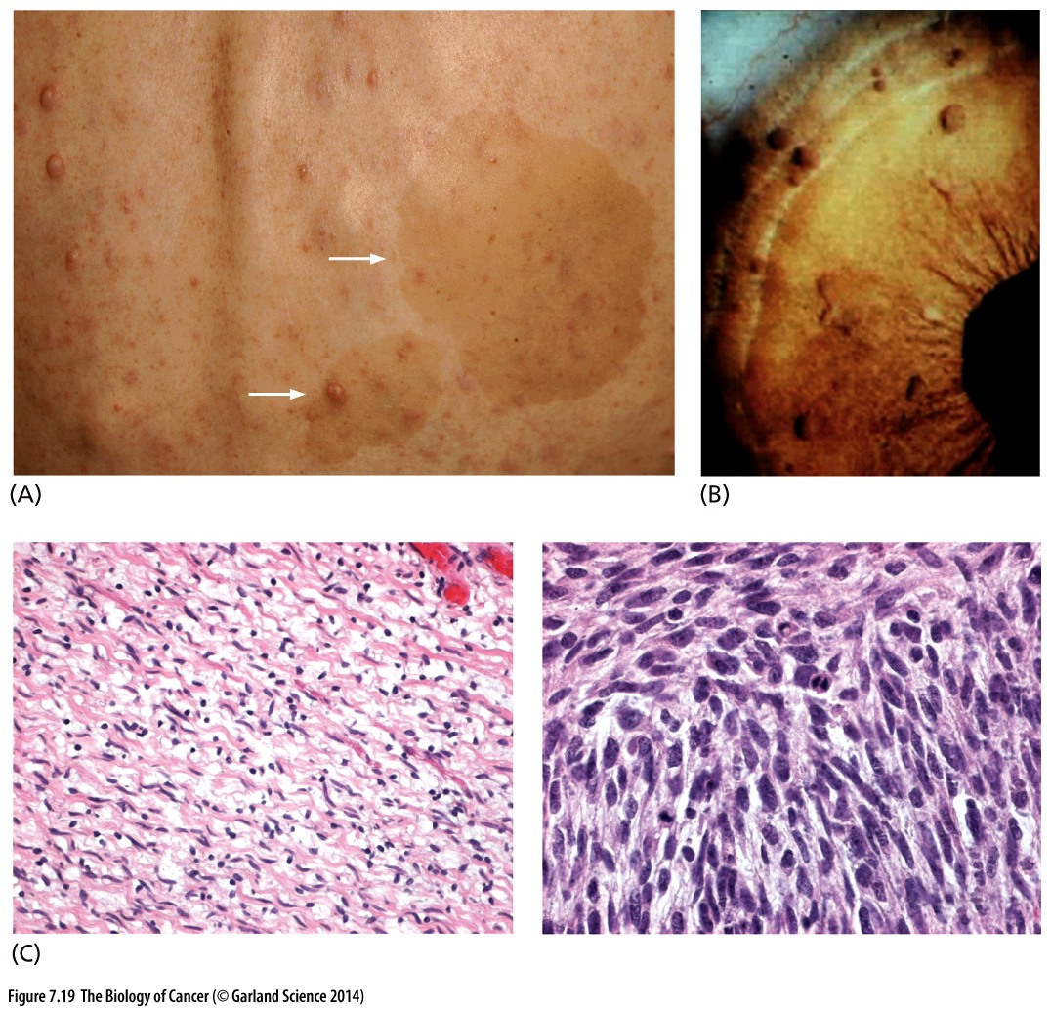
Figure 7.19 Neurofibromatosis
Neurofibromatosis type 1 is considered a syndrome because a number of distinct conditions are associated with a single genetic state. (A) Notable among these are the numerous small, subcutaneous nodules and the light brown café au lait spots (arrows) seen here on the back of a patient. (B) In addition, Lisch nodules are often observed in the iris(虹膜) of the eyes. (C) Histological observation of afflicted tissues indicates the benign neurofibromas (left), which occasionally progress to malignant peripheral nerve sheath tumors (MPNSTs, right). The histological complexity of the neurofibromas greatly complicated the identification of the normal progenitors of these growths, which are now thought to be the precursors of the Schwann cells that wrap around peripheral axons.

Slide 46
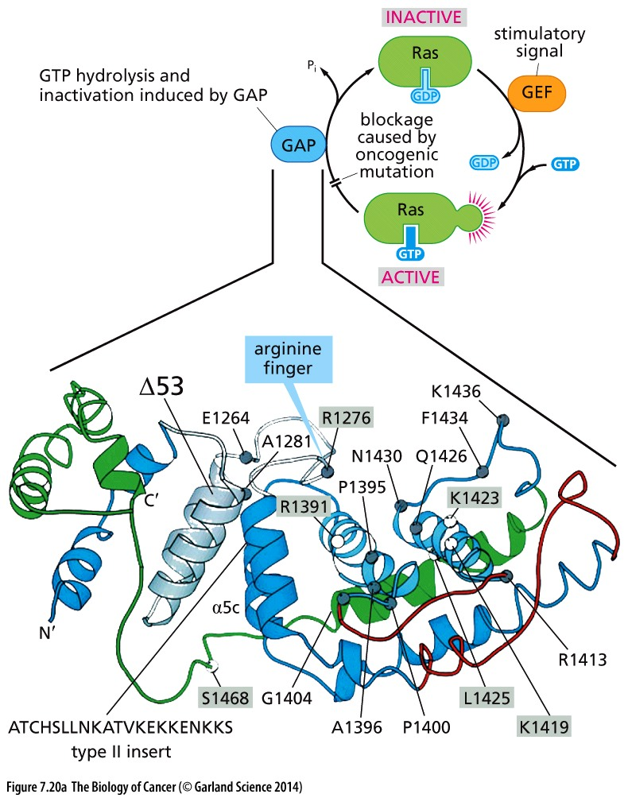
Figure 7.20 Neurofibromin and the Ras signaling cycle
As illustrated in Figure 5.30 and again here (upper right), the Ras protein passes through a cycle in which it becomes activated by a guanine nucleotide exchange factor (GEF), such as Sos, and inactivated by a GTPase-activating protein (a Ras-GAP). One of the main Ras-GAPs is neurofibromin (NF1), which can stimulate the GTPase activity of Ras more than 1000-fold.

Slide 47
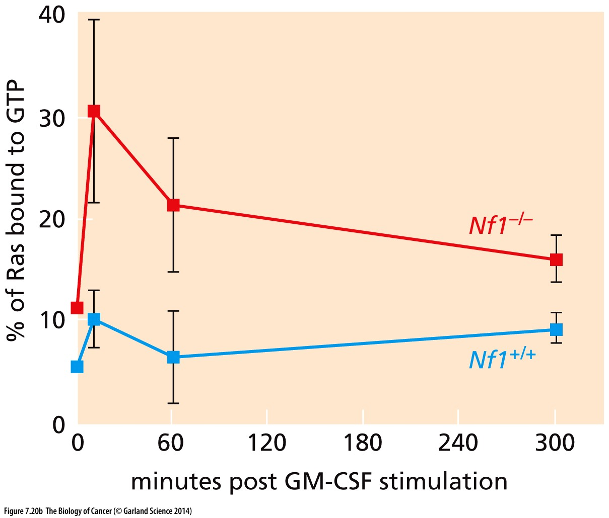
Figure 7.20 Neurofibromin and the Ras signaling cycle

Slide 48
NF1 in human cancer
For NF1, Significant number of inactivation mutation is observed
DESM (Broad 2015)
MPNST (MSKCC)
NEPC (Trento/Cornell/Broad 2016)
Breast (BCCRC Xenograft)
ALL (St. Jude)
GBM (TCGA 2008)
NCI-60
DESM : Desmoplastic Melanoma
MPNST: Malignant peripheral nerve sheath tumors
NEPC : Neuroendocrine prostate cancer
GBM: Glioblastoma Multiforme

Slide 49
7.11 Apc facilitates egress(外出) of cells from colonic crypts(结肠隐窝)

Slide 50
Familial adenomatous (腺瘤) polyposis(息肉)
While the great majority (>95%) of colon cancers appear to be sporadic, a small group arise as a consequence of inherited alleles that create substantial lifelong risk for this disease. The best understood of these heritable colon cancer syndromes is adenomatous polyposis coli, usually called familial adenomatous polyposis (FAP)

Slide 51
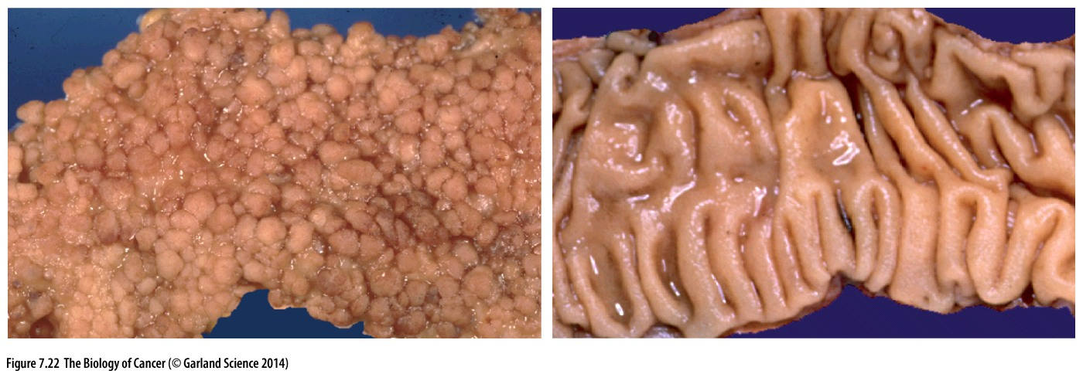
Figure 7.22 Familial adenomatous polyposis
The wall of the colon from an individual afflicted with familial adenomatous polyposis (FAP) is often carpeted with hundreds of small polyps (left); such polyps are absent in the smooth wall of a normal colon (right).

Slide 52
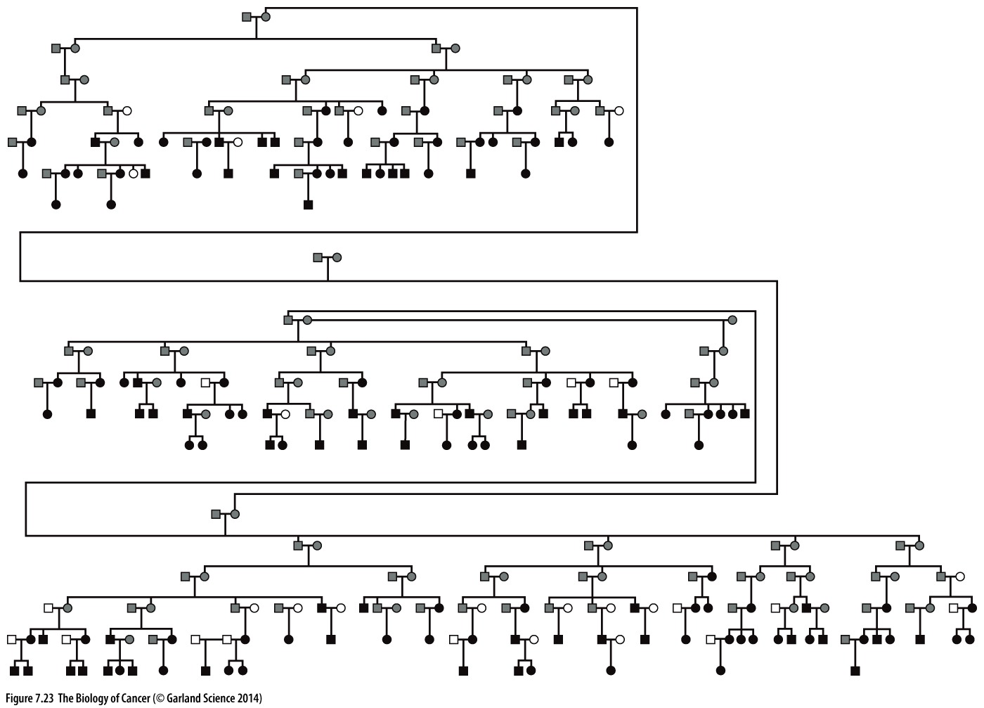
Figure 7.23 Genetic mapping using large kindreds(家族)
Dominant inheritance

Slide 53
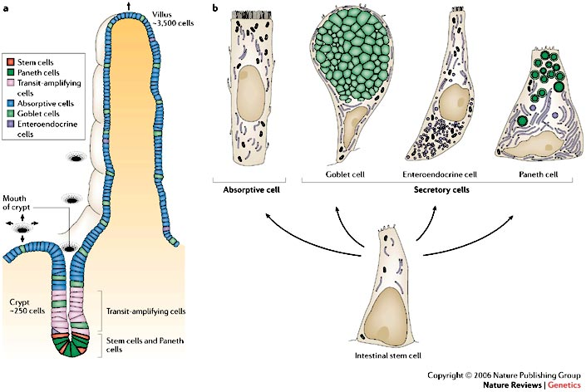
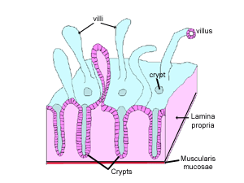
Colonic crypts (结肠隐窝)

Slide 54
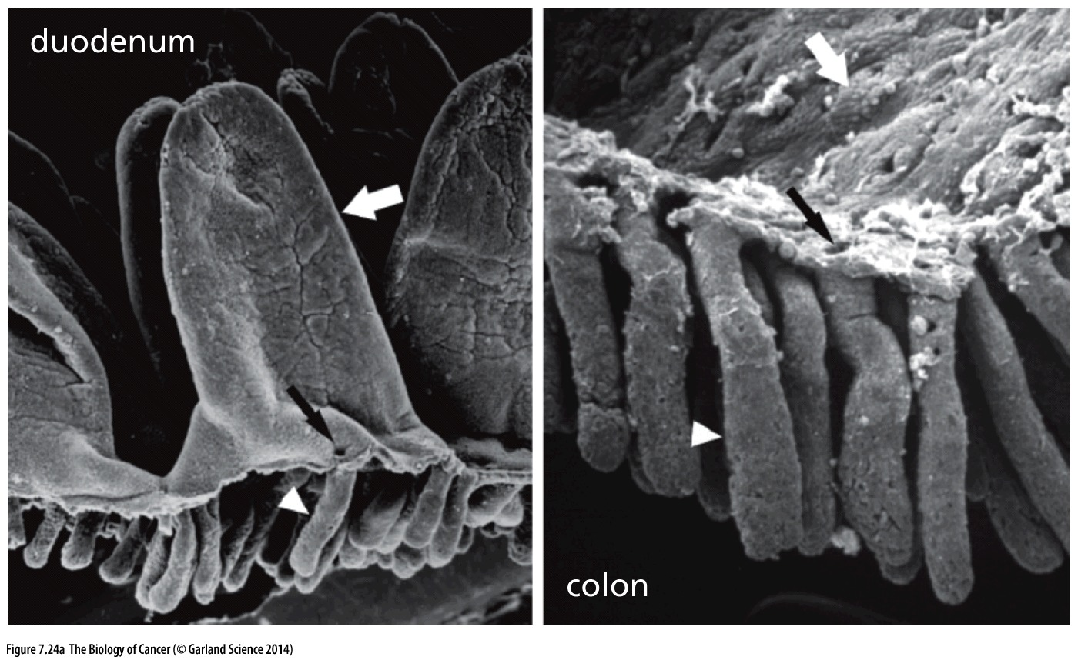
Figure 7.24 β-Catenin and the biology of colonic crypts(结肠隐窝)
(A) As seen in these scanning electron micrographs, the linings of the small (left) and large (right) intestines are organized similarly, with deep crypts (white arrowheads) in which stem cells reside and new enterocytes are produced that migrate toward the lumen (above), differentiate, and emerge via small openings (narrow black arrows). In the duodenum（ 十二指肠）, these newly born cells continue their upward migration along the sides of the fingerlike villi that protrude into the lumen (broad white arrow), while in the colon（结肠）, the villi are absent. In both cases, these cells are sloughed off after several days.

Slide 55
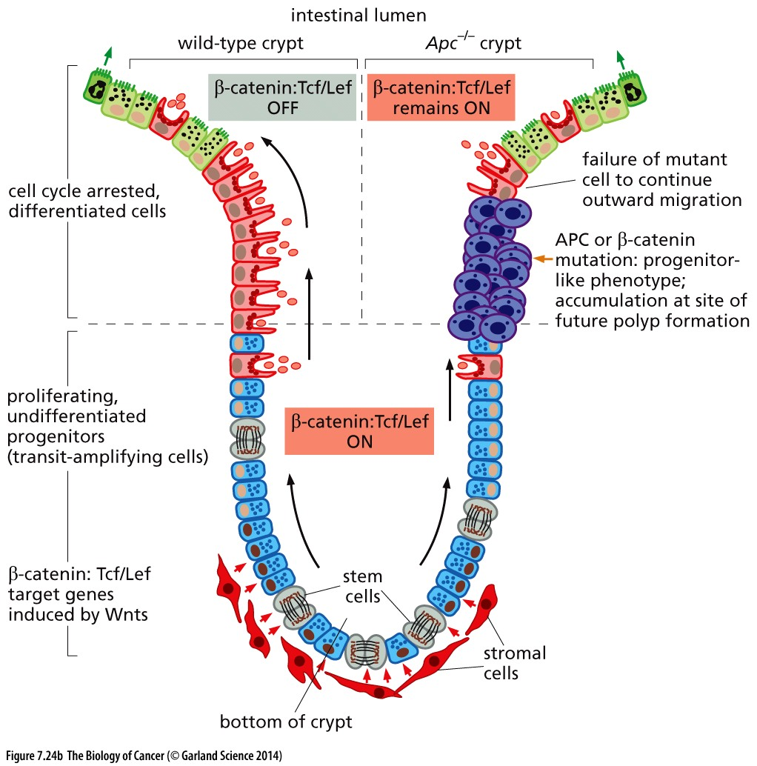
(B) The bottom of the colonic crypt contains replicating stem cells with high levels of β-catenin. Intracellular β-catenin levels are normally high in these cells because they are receiving paracrine
Wnt signals from stromal cells (red;
see Section 6.10). In the normal intestine
(left side of crypt), many of the progeny
of these stem cells migrate upward toward the lumen (above). As they do so, stimulation by stromal Wnts decreases and intracellular levels of APC increase; these two changes together lead to increased degradation of β-catenin in individual enterocytes, which results, in
turn, in cessation of proliferation and
increased differentiation as these cells
approach the lumen and ultimately enter
apoptosis after 3 to 4 days (small green
arrows).

Slide 56
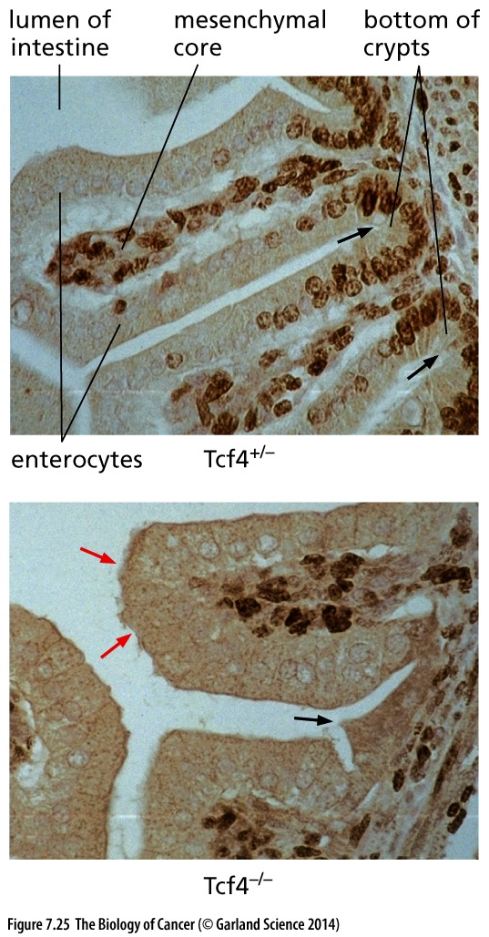
Figure 7.25 The Tcf4 transcription
factor and crypt development
The formation of the stem cell compartment near the bottoms of the crypts depends critically on the high levels of β-catenin and its ability to associate with the Tcf4 protein in the nucleus in order to form an active transcription factor complex. As seen in this figure, epithelial cells in the bottoms of the crypts of the small intestine of Tcf4^{+/–} mice (arrows, upper panel) are highly proliferative, as evidenced by the staining for Ki67, a marker of cell proliferation (dark brown nuclei). As they move out of the crypt up the sides of the villi, they lose proliferative potential. In Tcf4–/– mice (lower panel), in contrast, a layer of enterocytes is initially formed (red arrows), but the proliferating enterocyte stem cells in the crypts are absent (black arrow), and new enterocytes are not continually formed to replace those lost by apoptosis and sloughing into the intestinal lumen.
Notes:
基因敲除小鼠是研究基因体内功能的必备技术手段

Slide 57
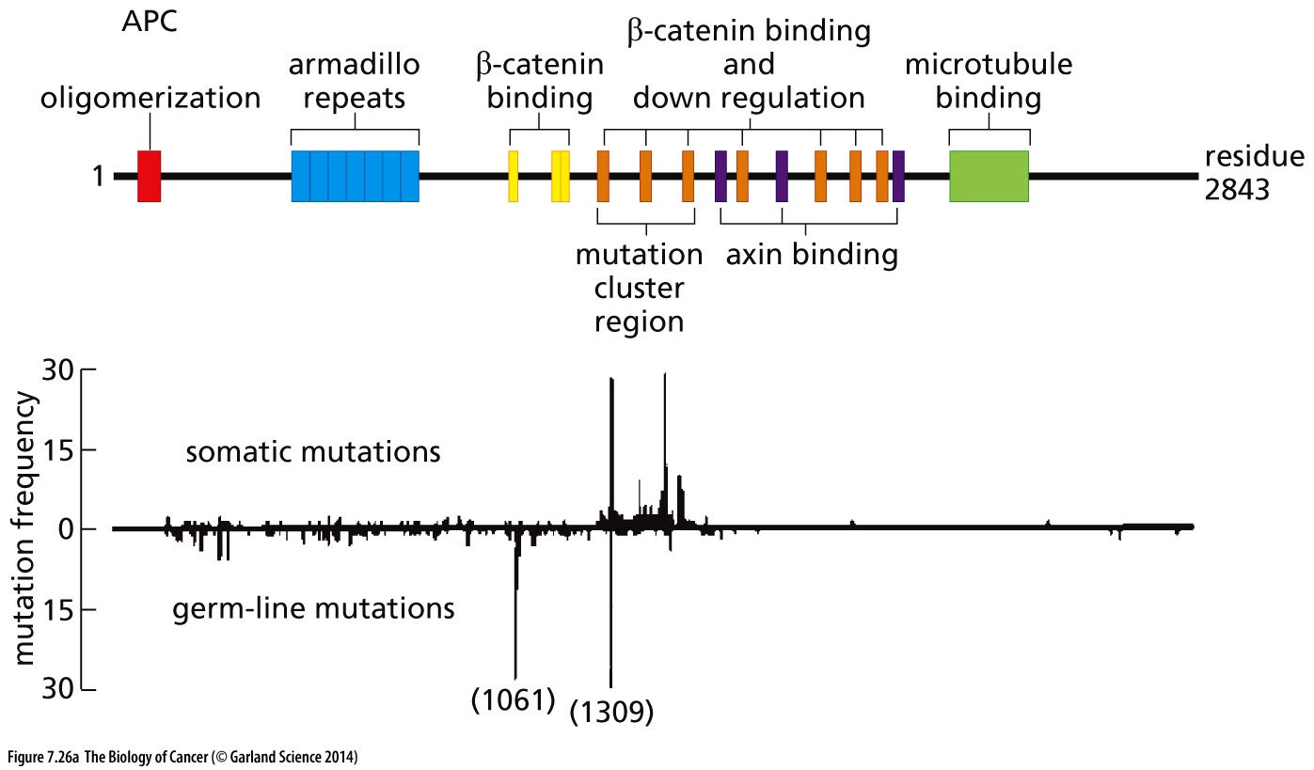
Figure 7.26 Apc, β-catenin, and Tcf/Lef
This diagram indicates in outline the multidomain structure of APC (above) with a plot of the spectrum of APC mutations and where they occur (below). The interactions of the microtubule-binding domain (light green) are important for proper regulation of cell motility and mitosis—a mechanistically unrelated function of this protein (see Figure 7.27).

Slide 58
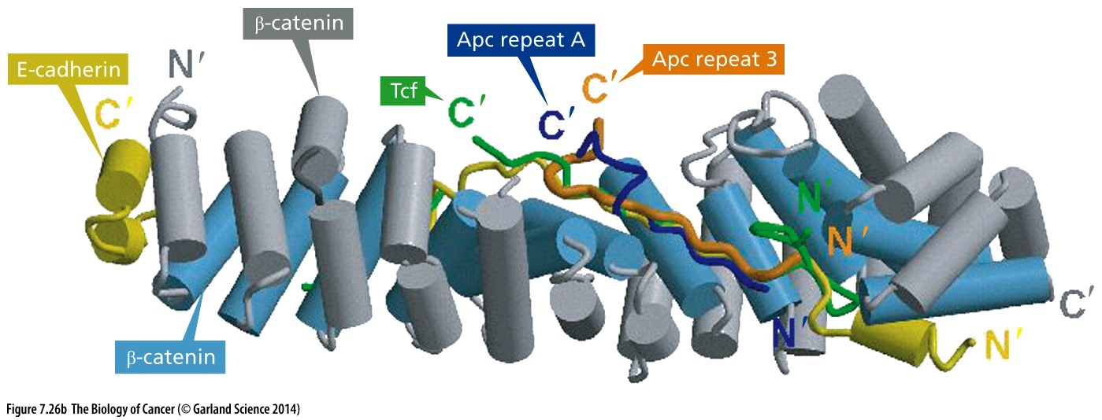
Figure 7.26 Apc, β-catenin, and Tcf/Lef
As is apparent, the β-catenin molecule (light blue, gray cylinders) associates with a number of alternative partner proteins during its life cycle.

Slide 59
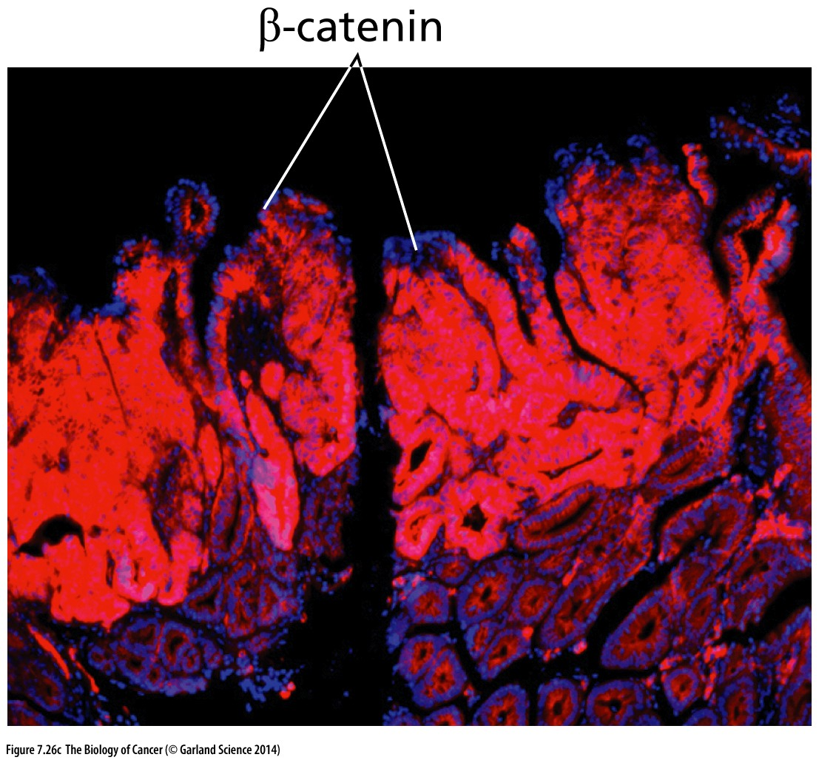
Figure 7.26 Apc, β-catenin, and Tcf/Lef
In the Min (multiple intestinal neoplasia) mouse model of familial polyposis, an inactivating point mutation was introduced into the Apc gene by the actions of a mutagenic chemical

Slide 60
7.12 Von Hippel–Lindau disease: pVHL modulates the hypoxic response

Slide 61
Von Hippel–Lindau syndrome
Von Hippel–Lindau syndrome is a hereditary predisposition to the development of a variety of tumors, including clear-cell carcinomas of the kidney, pheochromocytomas (tumors of cells in the adrenal gland(肾上腺)), and hemangioblastomas (blood vessel tumors) of the central nervous system and retina. Germ-line mutations of the VHL tumor suppressor gene have been documented in almost all of the patients suffering from the syndrome, which affects about 1 in 35,000 in the general population.
The German ophthalmologist Eugen von Hippel first described angiomas in the eye in 1904.
VHL gene was cloned in 1993
Latif F, Tory K, Gnarra J, et al. Identification of the von Hippel-Lindau disease tumor suppressor gene. Science. 1993;260:1317–1320.

Slide 62
VHL in human cancer
ccRCC (IRC)
ccRCC (TCGA)
ccRCC (TCGA pub)
ccRCC (U Tokyo)
ccRCC (BGI 2012)
Breast (BCCRC Xenograft)
NEPC (Trento/Cornell/Broad 2016)
Bladder (TCGA 2014)
Bladder (TCGA)
For VHL, Significant number of inactivation mutation is observed.
Especially in ccRCC (Clear cell renal cell carcinoma,肾透明细胞癌).

Slide 63
2016 Albert Lasker Basic Medical Research Award/2019 Nobel Prize
Oxygen sensing – an essential process for survival
Gregg L. Semenza, Identify HIF-1a in 1992;
Semenza GL, Wang GL. A nuclear factor induced by hypoxia via de novo protein synthesis binds to the human erythropoietin gene enhancer at a site required for transcriptional activation. Mol. Cell. Biol. 12:5447-5454 (1992).
Peter J. Ratcliffe, identify VHL function in 1999;
Maxwell PH, Wiesener MS, Chang GW, Clifford SC, Vaux EC, Cockman ME, Wykoff CC, Pugh CW, Maher ER, Ratcliffe PJ. The tumour suppressor protein VHL targets hypoxia-inducible factors for oxygen-dependent proteolysis. Nature. 1999 May 20;399(6733):271-5.
William G. Kaelin, identify VHL function in 1996;
Iliopoulos O, Levy AP, Jiang C, Kaelin WG Jr, Goldberg MA. Negative regulation of hypoxia-inducible genes by the von Hippel-Lindau protein. Proc Natl Acad Sci U S A. 1996 Oct 1;93(20):10595-9.

Slide 64
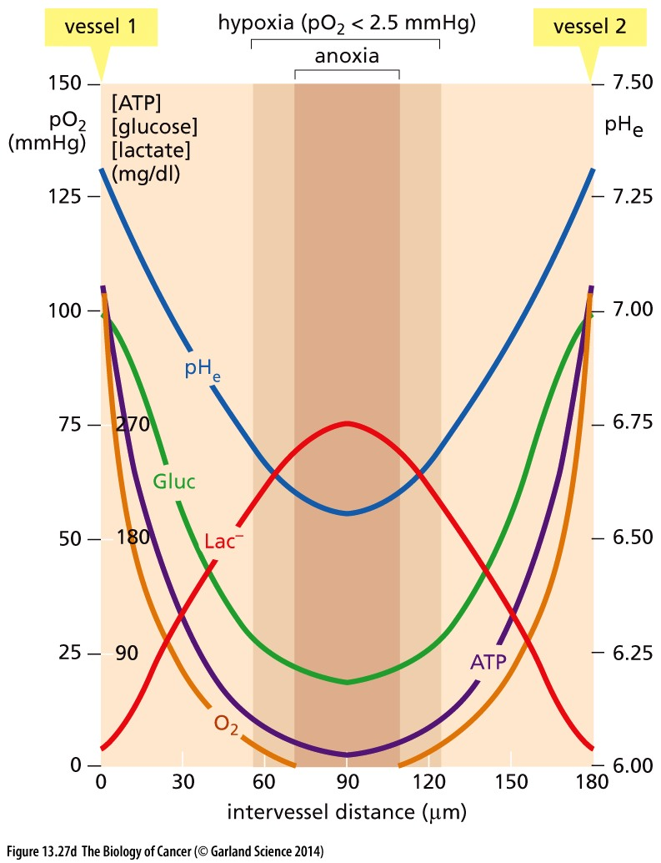
Hypoxia-inducible factor 1-alpha (HIF-1a)
HIF-1a is the master transcriptional regulator of cellular and developmental response to hypoxia (低氧).
Major HIF-1a targets:
VEGF: angiogenesis;
Glycolysis genes: Warburg effect;
Notes:
本课程第13次课还会讲到

Slide 65
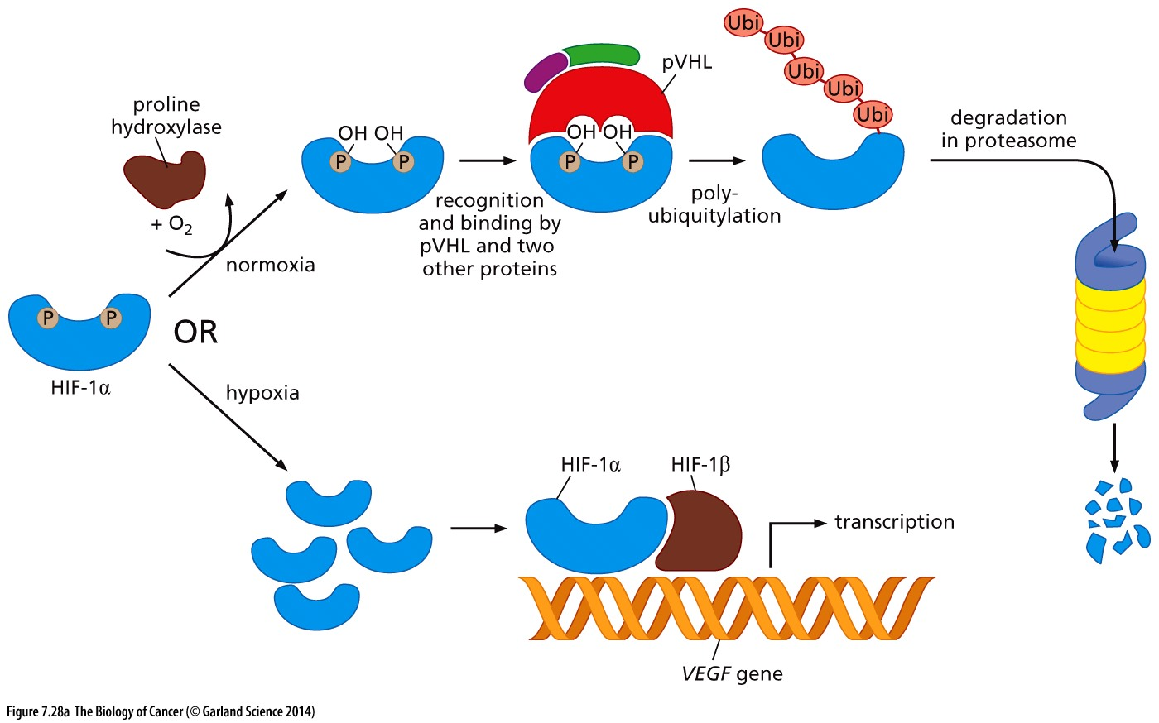
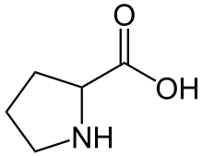
Figure 7.28 HIF-1 and its regulation by pVHL
Under conditions of normoxia, HIF-1α is synthesized at a high rate and almost immediately degraded. Degradation begins when proline hydroxylase, an iron-containing dioxygenase enzyme, oxidizes one or two proline residues (P) of HIF-1α to hydroxyproline (Hyp) residues. These hydroxyprolines enable the binding of pVHL to HIF-1α, which, together with several other proteins, tag HIF-1α by ubiquitylation, thus marking it for degradation. In contrast, under hypoxic conditions, proline hydroxylase fails to oxidize the two prolines of HIF-1α, which therefore escapes ubiquitylation, allowing its levels to increase rapidly.
Proline, 脯氨酸
Notes:
Hydroxylase n. 羟基酶；羟化酶

Slide 66
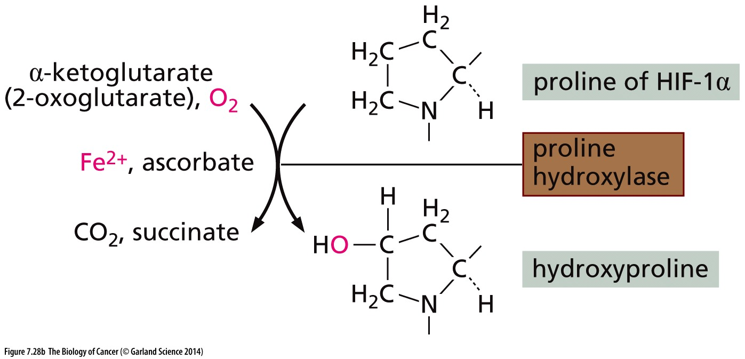
Figure 7.28 HIF-1 and its regulation by pVHL
α-Ketoglutarate, also known as 2-oxoglutarate, and oxygen serve as co-substrates in this reaction. α-Ketoglutarate and closely related metabolic intermediates may also serve as regulators of this process, which may explain the discovery of mutations in a series of Krebs cycle enzymes that have been discovered in human tumors (see Supplementary Sidebar 7.6).

Slide 67
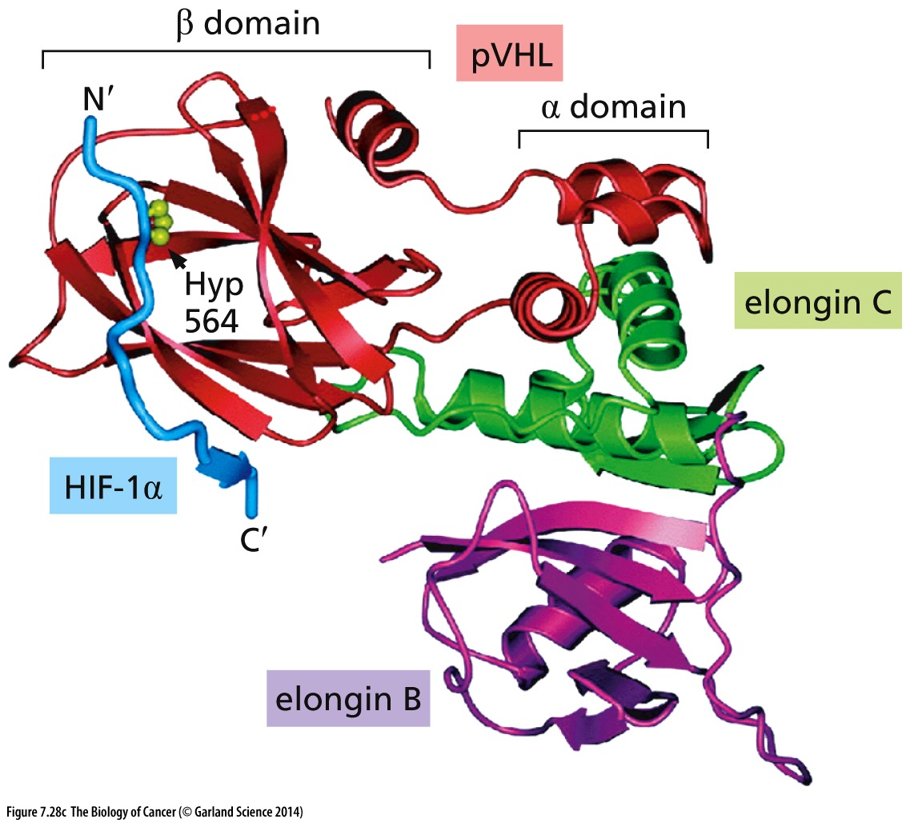
Figure 7.28 HIF-1 and its regulation by pVHL
(C) Shown is a ribbon diagram of a portion of HIF-1α after one of its prolines has been oxidized (for example, Hyp at residue 564, light green balls). This enables a domain of HIF-1α (light blue) to associate with a tripartite complex consisting of pVHL (red) and the proteins elongin B (purple) and elongin C (green) that ubiquitylates HIF-1α, which soon leads to its destruction in proteasomes.

Slide 68
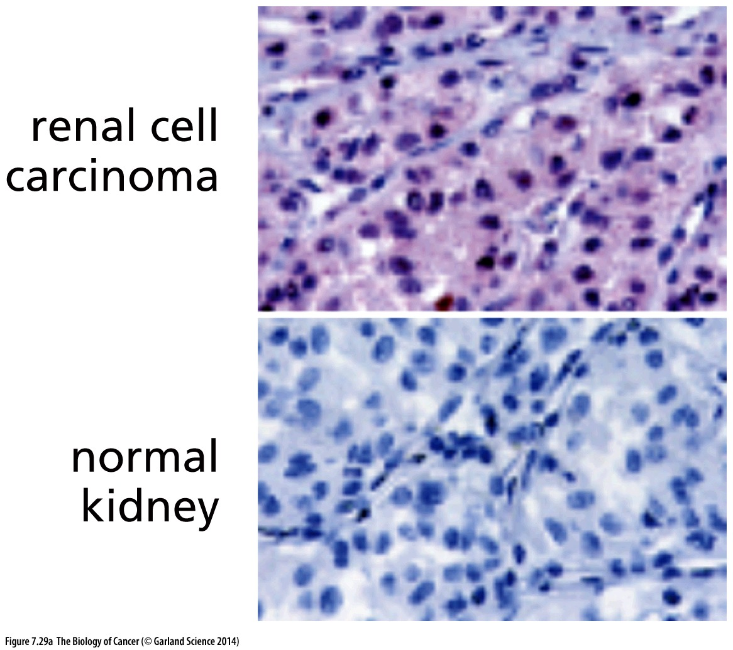
Figure 7.29 Biological consequences of VHL loss
High levels of HIF-2α are present in many cell nuclei (dark purple), while the protein is virtually undetectable in normal kidney tissue (below)

Slide 69
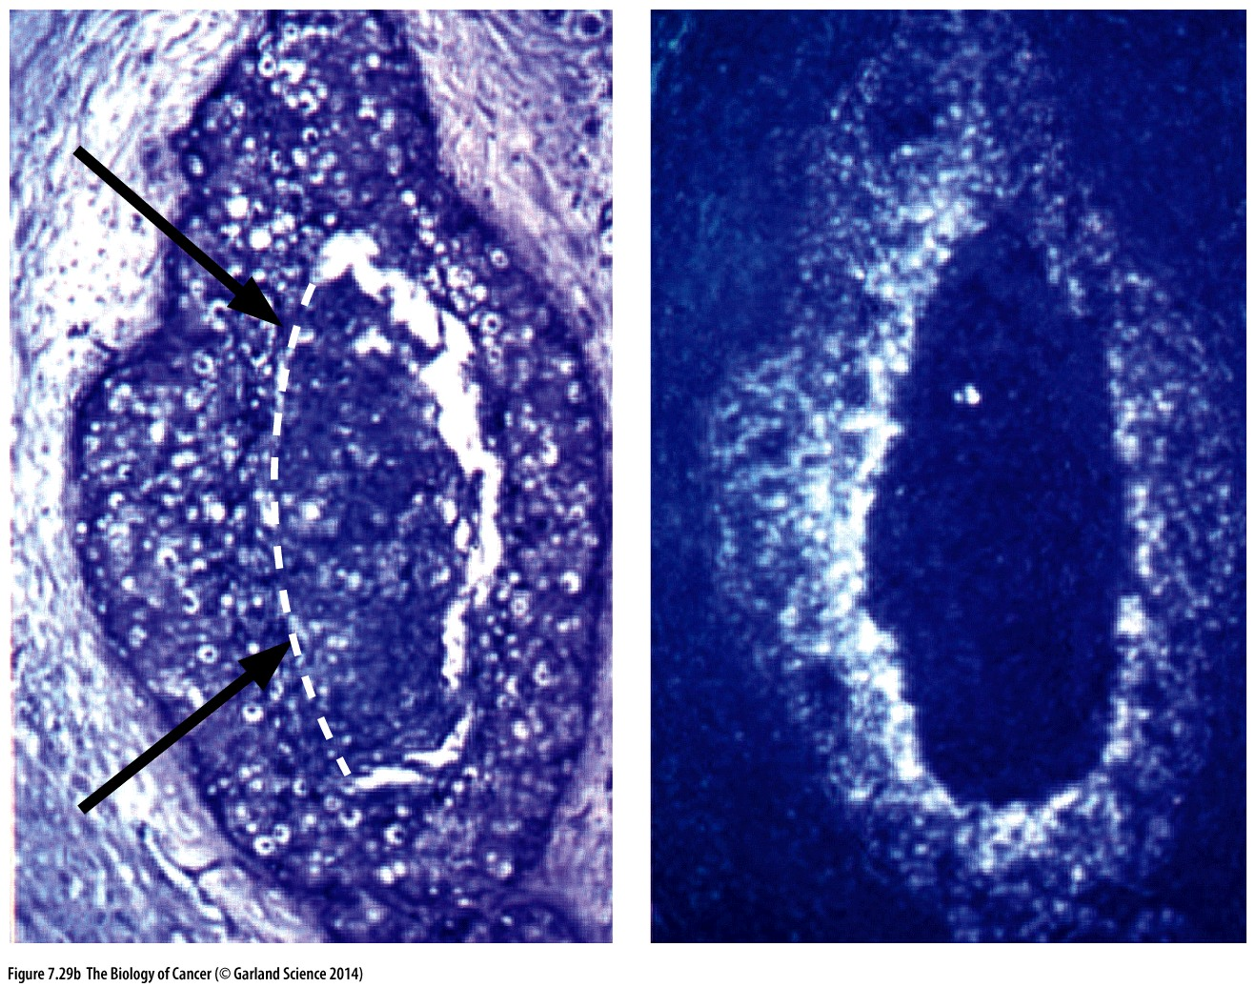
Figure 7.29 Biological consequences of VHL loss
Use of an in situ hybridization protocol (right) reveals that VEGF mRNA (white areas) is expressed in a gradient increasing from the low levels at the outer rim of the tumor (where oxygen is available) to the very intense expression toward the hypoxic center of the tumor.
VEGF expression in hypoxic region of tumor

Slide 70
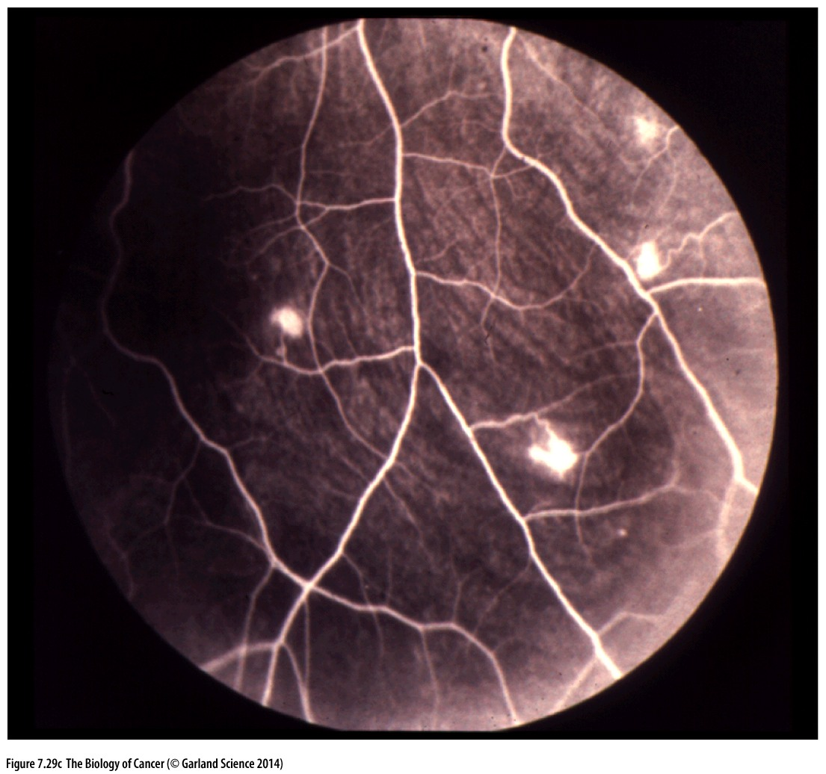
Figure 7.29 Biological consequences of VHL loss
One of the manifestations of von Hippel–Lindau syndrome is the presence of areas of uncontrolled vascularization in the retina, seen here as large white spots; these are ostensibly due to excessive production of VEGF in cells that have lost pVHL function.

Slide 71
Criteria for “tumor suppressor gene”
1, Decreased expression in cancer compared to normal tissue? （非充分，非必要）
2, At the center of loss of heterozygosity
3, Genetic alteration in familial cancer syndromes（充分，非必要）
4, Experimental evidence with genetic engineered mouse: Knockout mice show tumor phenotype; overexpression suppress tumor progression;
5, Human cancer genomics evidence：Enrich for inactivation mutation; Copy number loss; Function decreased;
Due to the heterogeneity of tumor formation, most tumor suppressors are only involved in the development of more circumscribed (局限的) sets of human tumors.
Notes:
有些tumor suppressor如P53参与几乎所有肿瘤发生，大部分tumor suppresor仅参与部分类型肿瘤发生

Slide 72
Oncogene, Tumor suppressor and others in cancer targeted therapy
Oncogene inhibition: eg. EGFR inhibitor
Tumor suppressor reactivation:
Gene therapy?
Indirect targeting the corresponding oncogenic pathway
Other cancer therapeutic target: Cancer addiction/dependent pathway;
Itself do not promote cancer, but specifically required for the survival of
oncogene activated/tumor suppressor inactivated cancer cells. eg. Proteasome inhibitor Velcade in multiple myeloma treatment.
Notes:
肿瘤靶向治疗的靶点有如下三类：。。。

Slide 73
思考题
1，简述2-hit hypothesis的含义，以及历史意义。
2，什么是loss of heterozygosity （LOH）？其意义和用途有哪些？
3，简述NF1参与肿瘤抑制的机制。
4，VHL是tumor suppressor的实验观察证据是什么？VHL参与肿瘤抑制的机制。

